Slide 1
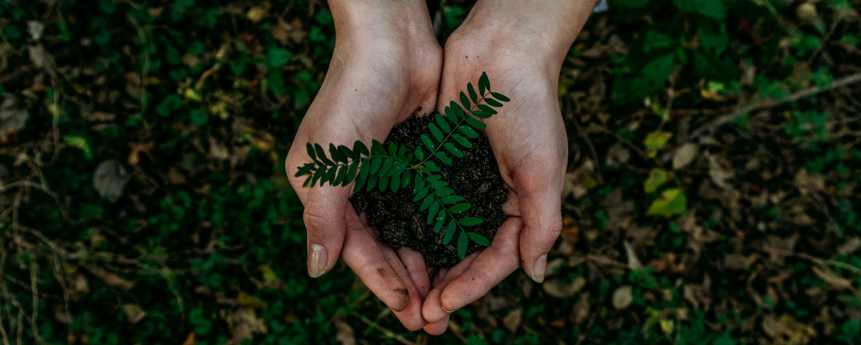
Climate Change & Sustainable Development
Photo by Noah Buscher, 2018, on Unsplash
Session 1: Introduction to Sustainable Development
Teacher’s name, email and date of session

Slide 2
Course outline
Part 1: Climate Change and Sustainable Development: An Introduction
Part II: Society, Sustainable Development and Climate Change
Part III: Environment and Sustainable Development
Part IV: Climate Change, Economy and Sustainable Development Interface
Part V: Action for Sustainable Development

Slide 3
Course outline
Part 1: Climate Change and Sustainable Development: An Introduction
Part II: Society, Sustainable Development and Climate Change
Part III: Environment and Sustainable Development
Part IV: Climate Change, Economy and Sustainable Development Interface
Part V: Action for Sustainable Development

Slide 4
Agenda
Introduction to Sustainable Development
  The concept of development
  Introduction, history and evolution of sustainable development
  Tragedy of the commons
  Sustainable Development as an approach to development
  Triple bottom line

Slide 5
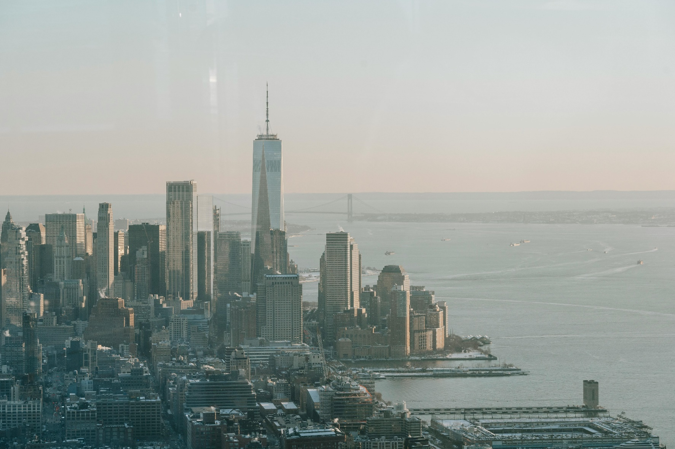
Topic 1
Concept of Development
Photo courtesy: Laura Tancredi from Pexels: https://www.pexels.com/photo/picturesque-cityscape-of-new-york-under-sundown-sky-7078467/

Slide 6
What do the terms ‘development’ and in particular, ‘sustainable development’ mean to you?

Slide 7
Some possible answers
Evolution and progress
Environment friendliness
Enahncing the current system
Balancing human and environmental needs
Reducing environmental damage
Efficient use of resources
Conservation of resources for future generations
Harmonious co-existence of humans and environment
Economic development
…

Slide 8
What is development?
‘By development I mean the movement upward of the entire social system, and I believe this is the only logically tenable definition. This social system encloses, besides the so-called economic factors, all noneconomic factors, including all sorts of consumption by various groups of people; consumption provided collectively; educational and health facilities and levels; the distribution of power in society; and more generally economic, social, and political stratification; broadly speaking, institutions and attitudes…’ (Myrdal, 1874, p.729).

Slide 9
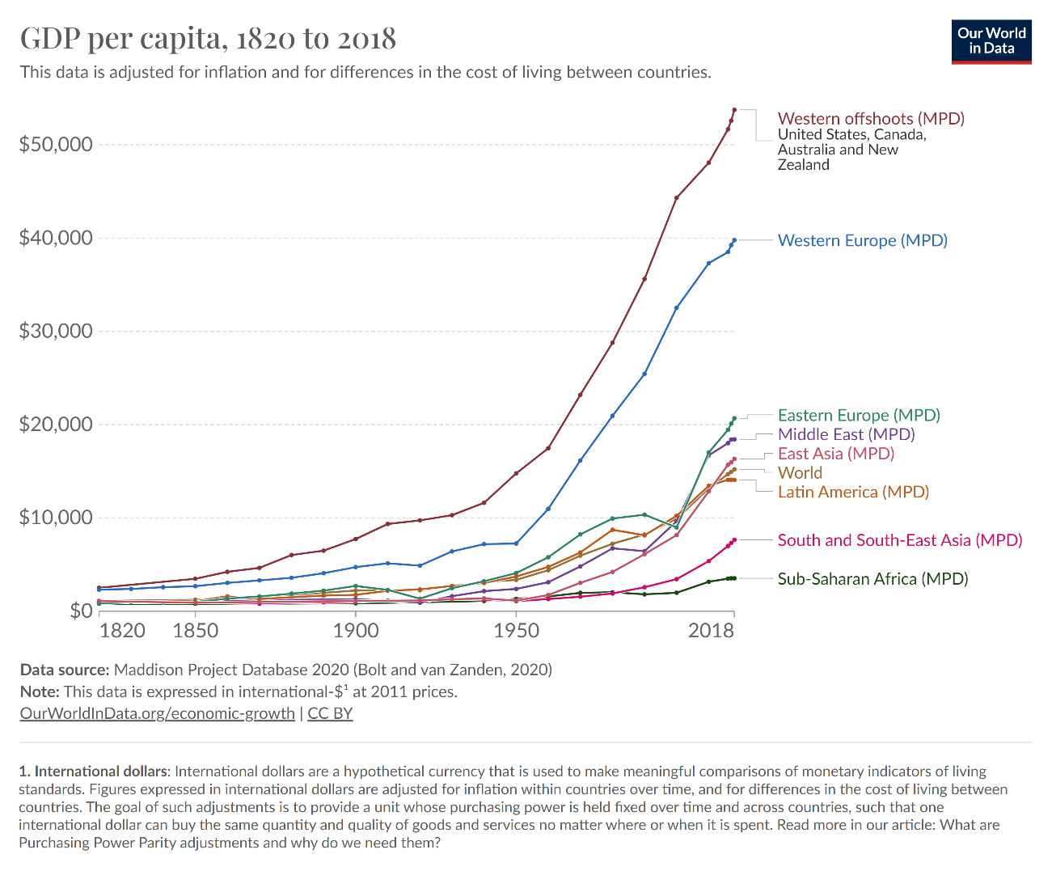
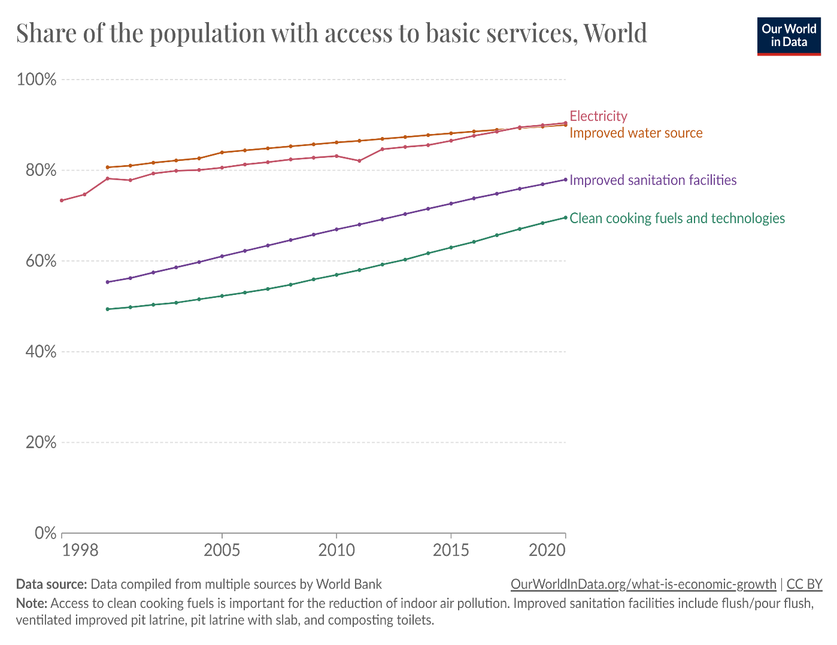
Development is about getting better
Source: Roser et al. (2023)

Slide 10
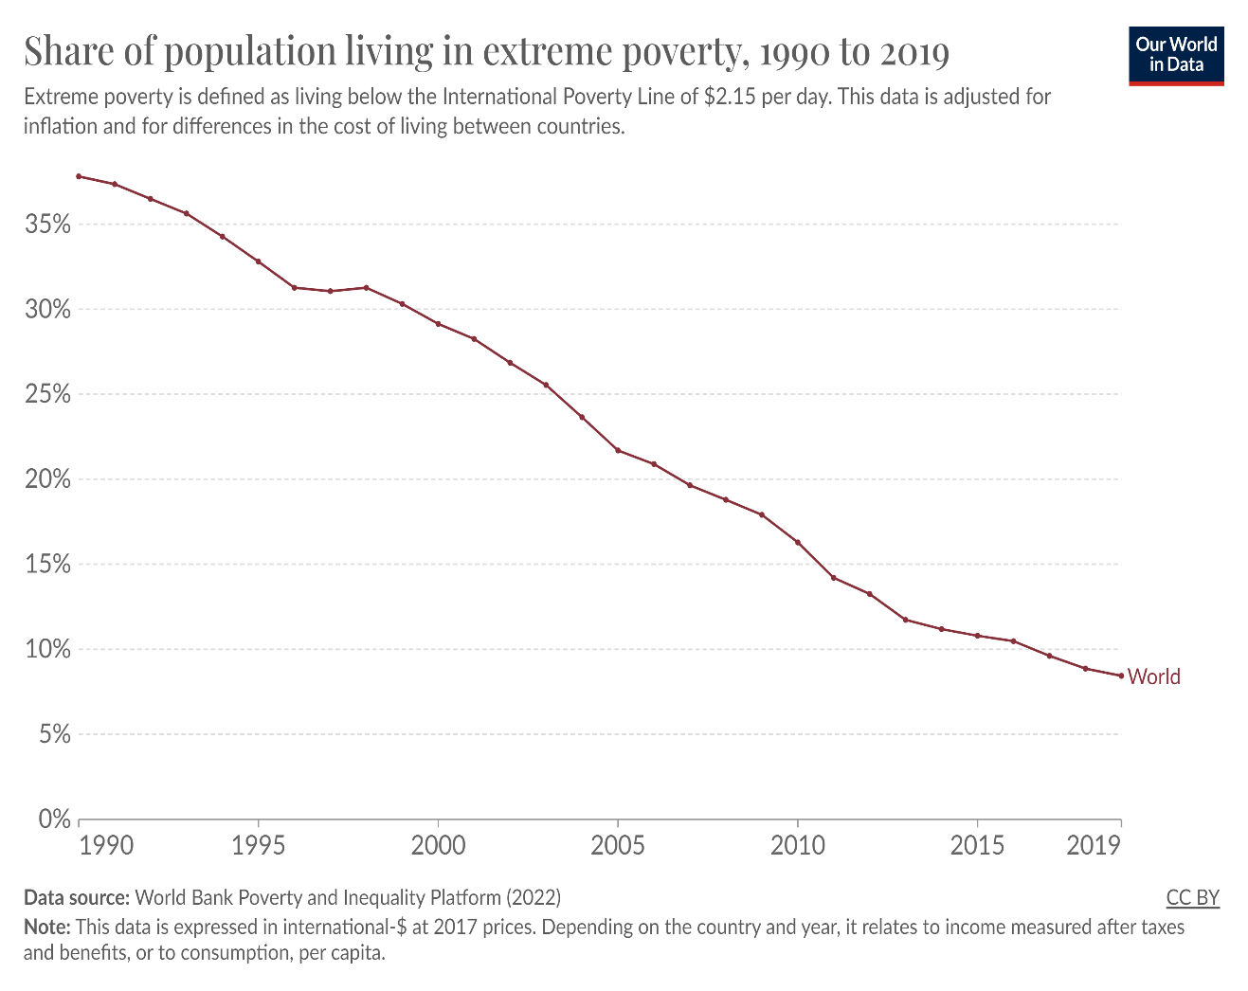
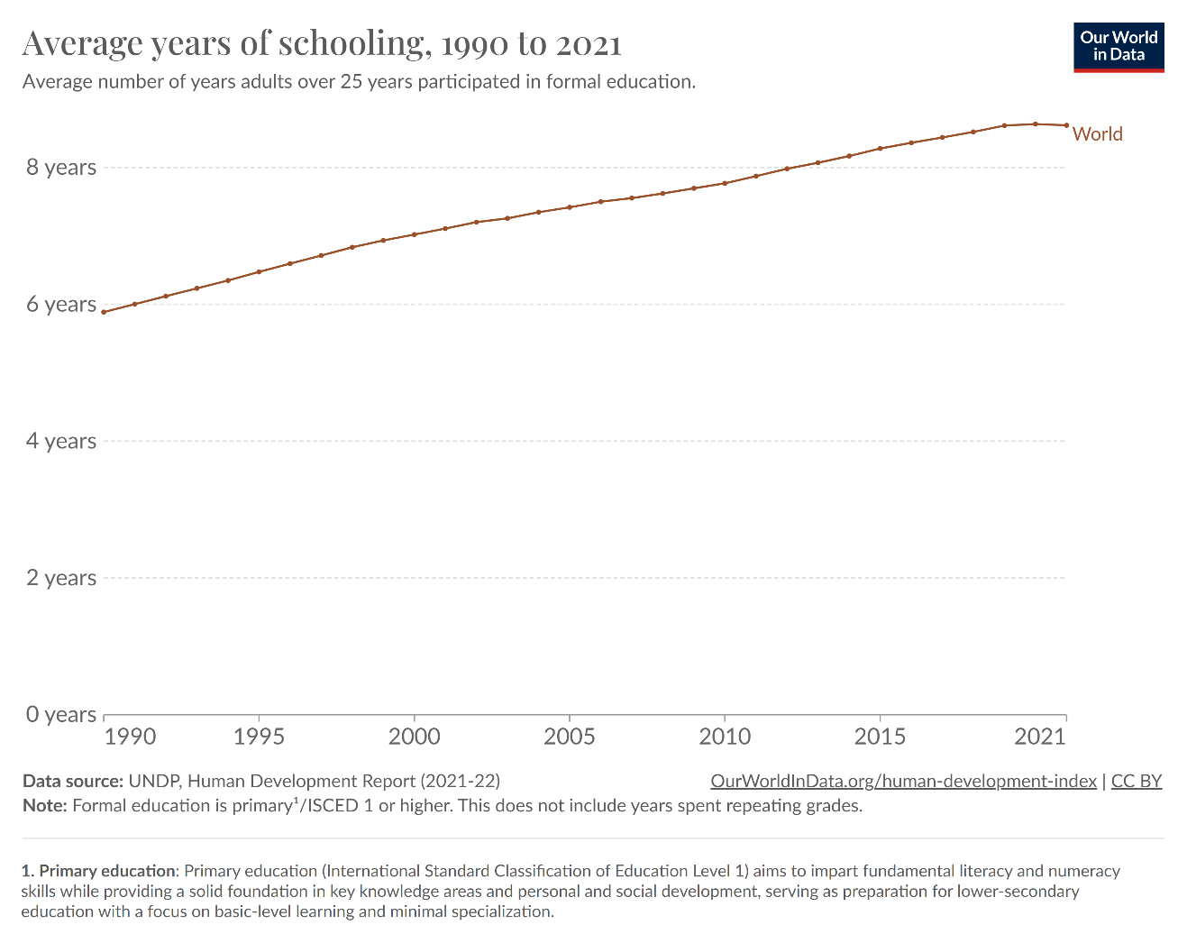
Development is about getting better

Slide 11
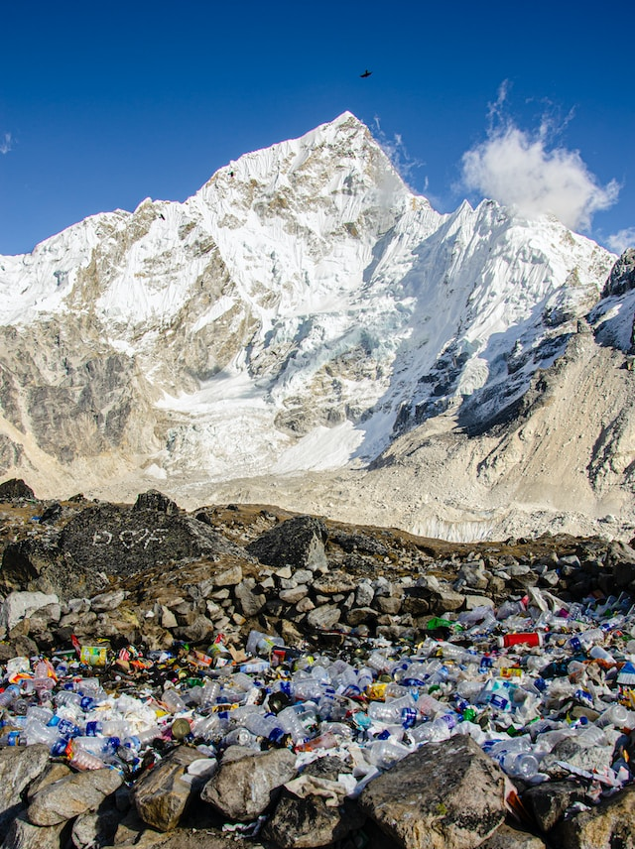
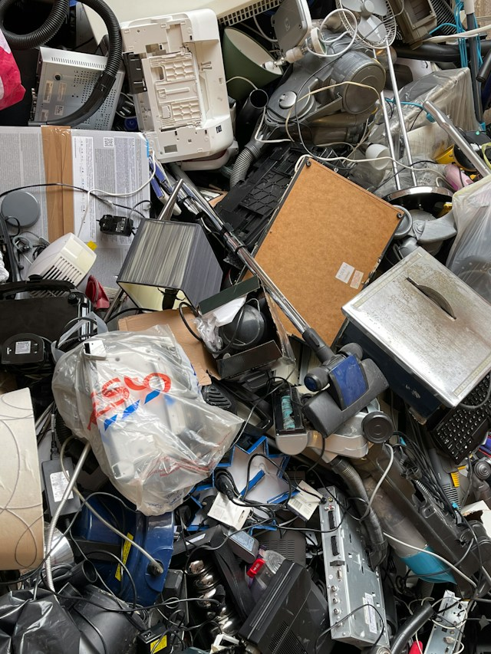
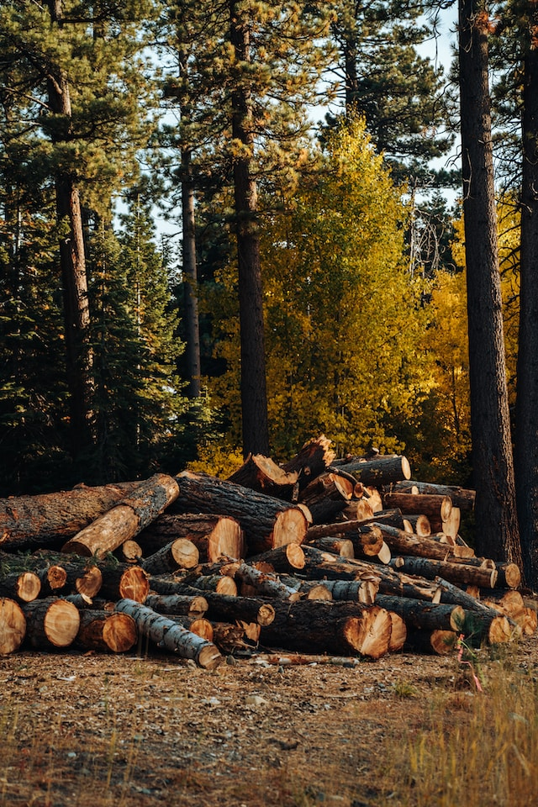
But are we actually doing any better?
Plastic waste
Electronic - waste
Deforestation
Source: Photo by Sylwia Bartyzel from Unsplash
Source: Photo by John Cameron from Unsplash
Source: Photo by Merrit Thomas from Unsplash
Notes:
What a Waste 2.0 report by World Bank estimates that in Sub-Saharan Africa and South Asia, waste generation will respectively double and triple due to urbanization and economic growth.

Slide 12
E-waste group activity
Determine the total number of students.
Count the total number of mobile phones you currently own.
Calculate the total number of mobile phones you have owned in the past 5 years, excluding the one you currently own.
Indicate how often you change your mobile phone for a new version (e.g., once a year, once every two years).
Estimate the approximate number of mobile phones you have changed in the past 5 years and discuss the implications.
Discuss how you dispose-off obsolete electronic devices and where e-waste usually ends up.

Slide 13
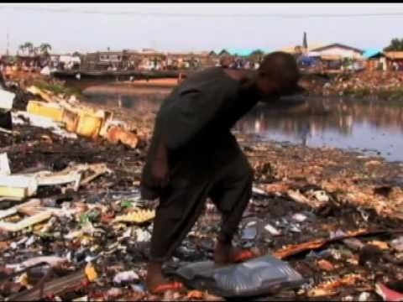

Short clip: Ghana digital dumping ground

Slide 14
Learnings from e-waste case
The prevailing development narrative primarily emphasizes economic growth without adequately considering the inherent risks associated with development. Often, these risks pose significant threats to both human well-being and the environment.
The goal of economic growth and development drives more output and consumption, sometimes without regard for the implications of our decisions. The notion of sustainable development emerged in the 1980s in response to a rising awareness of the negative environmental consequences that began to emerge during that time period.

Slide 15
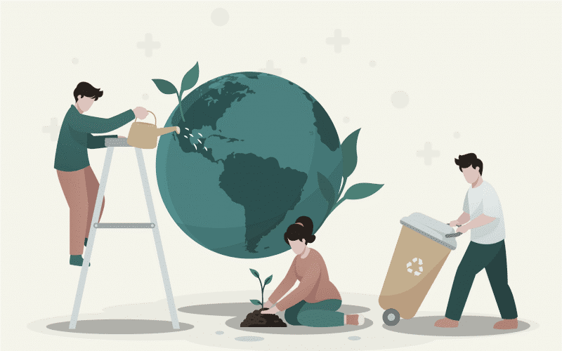
Topic 2
Introduction, History and evolution of Sustainable Development
Photo courtesy: Leverageedu (2024). https://leverageedu.com/blog/concept-of-sustainable-development/

Slide 16
Development vs Sustainable Development
Development
Sustainable Development
- Development is mostly used as an `economic´ concept.
- Wealth generation is at the heart of the development paradigm.
- Natural resources are the basic condition for development.
- Centered on resource exploitation and maximization of resource use.
- Treat environmental deterioration as an inevitable consequence of development.
- Needs of the current generation only.
- Sustainable development is a multidisciplinary concept, a mix of socio-economic and environmental development.
- Sustainable development is people-centered and society is a key pillar.
- Human resources as the focus of sustainable development.
- Oriented toward conservation and sustainable usage of resources.
- Equal focus on current as well as future generations.
Source: Rogers et al. (2007)

Slide 17
The concept of Sustainable Development
Report “Our common Future”: Sustainable development is development that meets the needs of the present without compromising the ability of future generations to meet their own needs (The Brundtland Commission, 1987).
This definition has two key concepts:
(1) ‘needs’, in particular “the essential needs of the world’s poor,”
(2) ‘limitations’, meaning “limitations imposed by the state of technology and social organization on the environment’s ability to meet present and future needs”.

Slide 18
The concept of Sustainable Development
Economic Development
Environmental Protection and Enhancement
Social Well-being
The principles of sustainable development consist of economic, societal, and environmental considerations

Slide 19
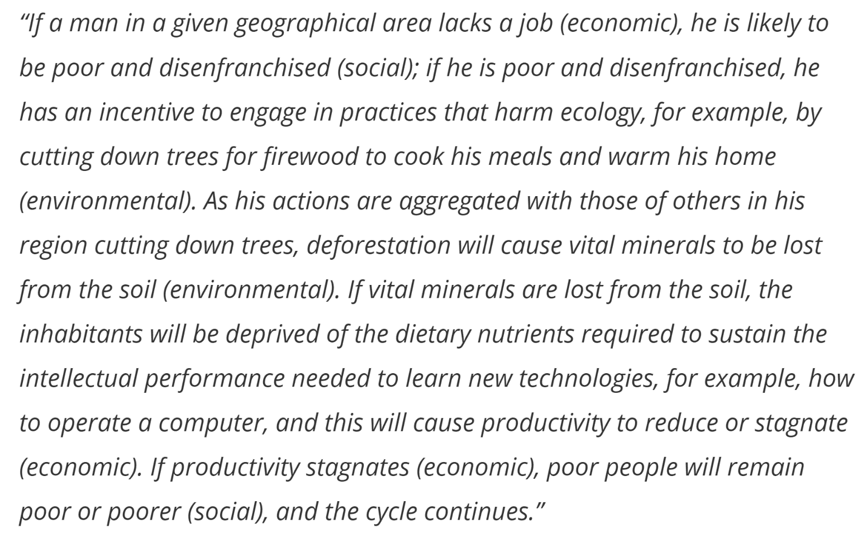
Interconnections among the environment, economy and society
Source: (Basiago, 1998)

Slide 20
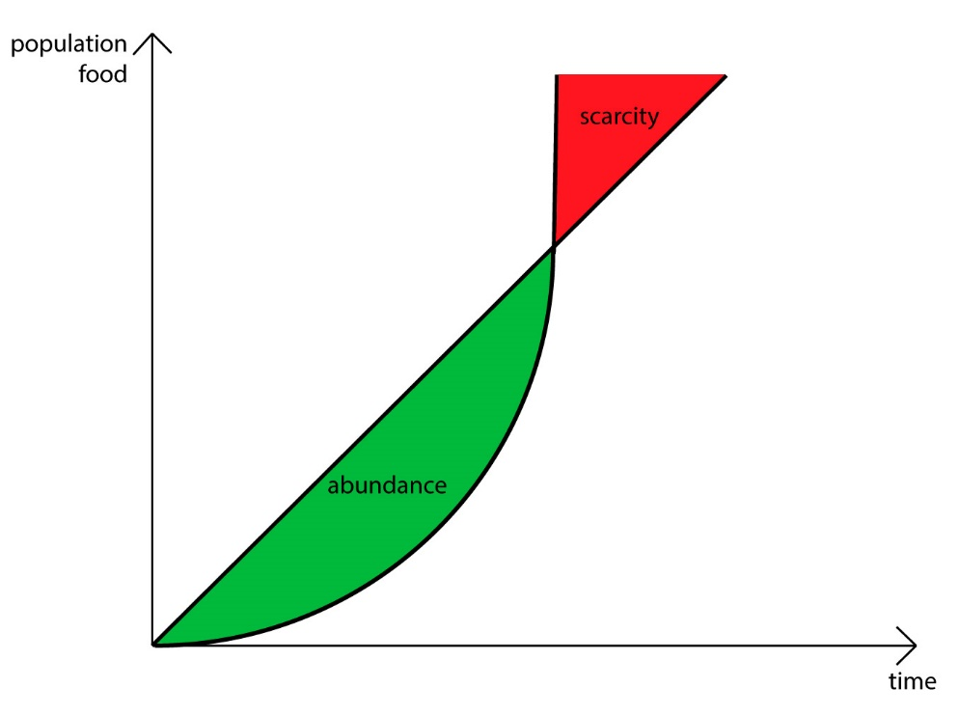
Historical perspective
- Early 1800s: The very first indirect reference to sustainable development was made by Thomas Robert Malthus. In 1789, he published “An essay on the principle of population.” observed that, while resources tended to grow arithmetically, populations exhibit exponential growth.
He predicted that the world’s population would eventually starve or, at the least, live at a
minimal level of subsistence because food production could not keep pace with the growth of population.
Food growth
Population growth
Picture source: Policonomics. 2023. Website. https://policonomics.com/malthusian-population-theory/

Slide 21
Historical perspective
According to him, the consequences of massive population growth would be disease, famine, war, and calamity.
His theory states that if population growth is left unrestricted, human populations would continue to grow until they would become too large to be supported by the food grown on available agricultural land.

Slide 22
Historical perspective
- 1972: Limits to Growth, report by Club of Rome - exponential economic growth in a world with a finite supply of resources can lead to a variety of negative global scenarios. This report was based on comparative data on growth of population, industrial production and pollution and concluded that exponential growth of these variables would eventually reach the limit (Mensah, 2019). He further claimed that the limit is just one generation away (Basiago, 1998).
- 1987: The Brundtland Commission report titled ‘Our Common Future’. It defined the concept concretely for the first time. The definition used until today is from this report.

Slide 23
Historical perspective
- 1992: Rio Earth Summit – One of the major outcome was ‘Agenda 21’, which claimed that sustainable development should become a priority item on the international community's agenda. It also urged that national policies be devised and implemented to address the economic, social, and environmental components of sustainable development.
- 2012: Ten years after Rio Summit, Rio+ 20 was held which reaffirmed the commitment towards sustainable development. The conference document ‘The future we want’ mentions the term sustainable development 238 times in a 49 page document (Mensah, 2019).

Slide 24
Relevance of the concept
As the population grows, the availability of natural resources to meet human needs and desires remains static.
Earth’s resources are finite and will eventually run out.
Excessive consumption and production is leading to the depletion of natural resources, environmental degradation, and the exacerbation of social and economic inequalities.

Slide 25
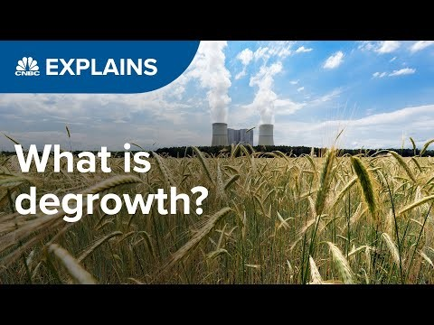
The new degrowth movement
Double click to start the video

Slide 26
What‘s your take on degrowth theory?
- Do you think that the concept of sustainable develpment corelates with lack of growth? Why or why not?
- Do you think degrowth will deliver well-being and reduce income and wealth inequalities?
- The degrowth theory postulates that ”The solution lies in moving away from the assumption that growth is good”. Do you agree with this statement? Why or why not?
Double click to start the video

Slide 27
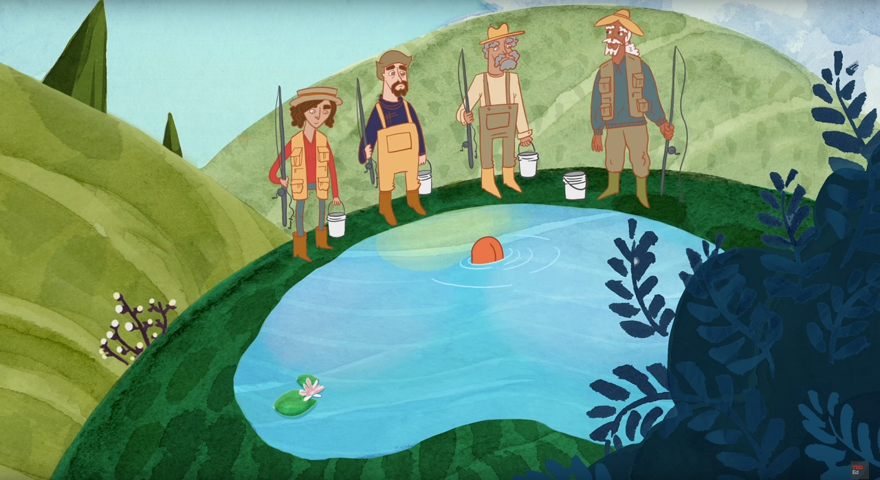
Topic 3
Tragedy of the commons
Photo courtesy: Nicholas Amendolare illustration

Slide 28
Imagine…
All of you are fishermen and you are each fishing in a pond. The pond represents a shared environment, and your catch contributes to the overall health of the fishing ecosystem.
As individual fishermen, all of you would want to catch as many fish as possible to benefit personally.
What do you think would happen to the fish population in 5, 15 and 50 years?

Slide 29
Tragedy of the commons
In 1968, the term “tragedy of the commons” was used for the first time by Garret Hardin.
The tragedy of the commons refers to a situation in which individuals with access to a public resource (also called a common) act in their own interest and, in doing so, ultimately deplete the resource. This can result in overconsumption, underinvestment, and depletion of resources (Hardin, 1968).
Hardin contends that human short-term interests--taking as much of a resource possible--are opposed to societal good. If everyone acts on this selfish interest, the situation would worsen for society as a whole.

Slide 30
Example: The Tragedy of the Commons in Car Washing Practices in Pakistan
Car washing is a regular practice at our homes in Pakistan.
If every resident of the country decides to wash their cars daily without any consideration for water conservation, the shared water source may be overused and depleted, leading to consequences like water scarcity or increased water bills for everyone.
This example also signifies an underlying assumption of the theory: Without transparency and regulations, individuals will have little or not incentive to refrain themselves from taking too much.

Slide 31
Example: The Tragedy of the Commons in global coffee consumption
While a simple cup of coffee may appear simple, it is an excellent example of the tragedy of the commons.
Coffee plants are a naturally occurring shared resource, but overconsumption has resulted in habitat destruction, threatening 60 percent of the plant's species, including the most widely brewed Arabica coffee (HBS, 2019).

Slide 32
Solution: Tragedy of the Commons
- Fostering a sense of collective responsibility and implementing sustainable practices, we can mitigate the Tragedy of the Commons in various aspects of our lives.
- Sustainable development can address the Tragedy of the Commons by promoting responsible resource management. It involves creating and implementing policies that balance economic, social, and environmental aspects, ensuring the equitable use of shared resources for current and future generations.

Slide 33
Key take aways
- Sustainable development is an essential issue in today's society since it addresses environmental concerns, economic success, and social equality.
- It evolved in response to the severe environmental and social repercussions of unilateral economic development tactics following the Industrial Revolution, as well as a shift in human views about the concept of growth and development.

Slide 34
Optional class activity/ Home task
Propose your own definition of sustainable development based on the aspects of sustainability that you think are important and your understanding of this concept.

Slide 35
References
Myrdal, G. (1974). What Is Development?. Journal of Economic Issues, 8(4), 729-736, DOI: 10.1080/00213624.1974.11503225.
Brundtland, G.H. (1987). Our Common Future: Report of the World Commission on Environment and Development. Geneva, UN-Dokument A/42/427.
UNDP. (2022). Global Rise of Education. Published online at OurWorldInData.org. Retrieved from: ‘https://ourworldindata.org/grapher/average-years-of-schooling?tab=chart&country=~OWID_WRL’. [Online Resource].
Roser, M., Arriagada, P., Hasell, J., Ritchie, H., and Ortiz-Ospina, E. (2023). Economic Growth. Published online at OurWorldInData.org. Retrieved from: 'https://ourworldindata.org/economic-growth' [Online Resource].
Rogers, P.P., Jalal, K.F., & Boyd, J.A. (2007). An Introduction to Sustainable Development (1st ed.). Routledge. https://doi.org/10.4324/9781849770477.
Hardin, G. (1968). The Tragedy of the Commons. Science, 162(3859), 1243–1248.
HBS. (2019, February 6). Tragedy of the Commons: Examples & Solutions | HBS Online. Business Insights Blog. https://online.hbs.edu/blog/post/tragedy-of-the-commons-impact-on-sustainability-issues

Slide 36
Further Resources for teachers
Strange, T., & Bayley, A. (2008). Sustainable Development: Linking Economy, Society, Environment. https://doi.org/10.1787/9789264055742-en
Redclift, M., & Springett, D. (2015). Routledge International Handbook of Sustainable Development. Routledge.
WeForum. (2022, June 15). Degrowth: What’s behind this economic theory and why it matters today. World Economic Forum. https://www.weforum.org/agenda/2022/06/what-is-degrowth-economics-climate-change/.
Piper, K. (2021, August 3). Can we save the planet by shrinking the economy? Vox. https://www.vox.com/future-perfect/22408556/save-planet-shrink-economy-degrowth.
Bac, D. P. (2008). A history of the concept of sustainable development: Literature review. 17.

Slide 37
Notes for Teachers
Slide 9 & 10: More information on the grapgh can be found at these links:
GDP per capita: https://ourworldindata.org/grapher/gdp-per-capita-worldbank
Access to basic services: https://ourworldindata.org/grapher/access-to-basic-services
Share of population living in extreme poverty: https://ourworldindata.org/grapher/share-of-population-in-extreme-poverty
Average year of schooling: https://ourworldindata.org/grapher/average-years-of-schooling

Slide 38
Notes for Teachers
Slide 11: What a Waste 2.0 report by World Bank estimates that in Sub-Saharan Africa and South Asia, waste generation will respectively double and triple due to urbanization and economic growth.
  Global plastic waste continues to be a pressing environmental issue, with millions of tons of plastic ending up in landfills, oceans, and ecosystems each year. Despite efforts to address the problem, the accumulation of plastic waste poses significant threats to wildlife, marine ecosystems, and human health worldwide.
  Discarded electronic gadgets pollute the environment and pose health hazards. Improper e-waste disposal and recycling lead to the discharge of harmful compounds into the environment, endangering ecosystems and human health.
  Deforestation has serious environmental implications, such as biodiversity loss, ecosystem instability, soil erosion, and impacts to climate change through the emission of carbon dioxide from trees.
Slide 13: Double click on the image to play the video. Alternatively, click on the image and go to ‘Format’ in the panel above. Click on the play button from the top left menu to play the video. The playback time of the video is 3 mins 58 seconds.

