Slide 1
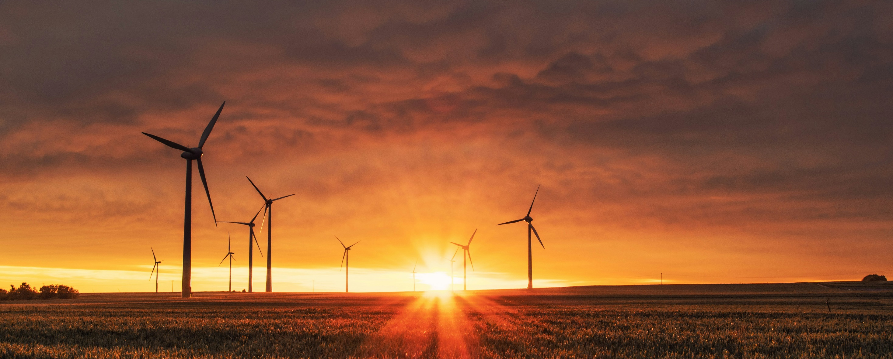
Climate Change & Sustainable Development
Photo by Karsten Würth on Unsplash
Session 2: Pillars and Principles of Sustainable Development
Teacher’s name, email and date of session

Slide 2
Course outline
Part 1: Climate Change and Sustainable Development: An Introduction
Part II: Society, Sustainable Development and Climate Change
Part III: Environment and Sustainable Development
Part IV: Climate Change, Economy and Sustainable Development Interface
Part V: Action for Sustainable Development

Slide 3
Agenda
Pillars and Principles of Sustainable Development
  The three pillars of sustainable development
  Principles of sustainable development

Slide 4
Home Task update: Your own definitions of Sustainable Development
*Write key words here.
See slide ‘Notes for Teachers‘ for conducting this activity

Slide 5
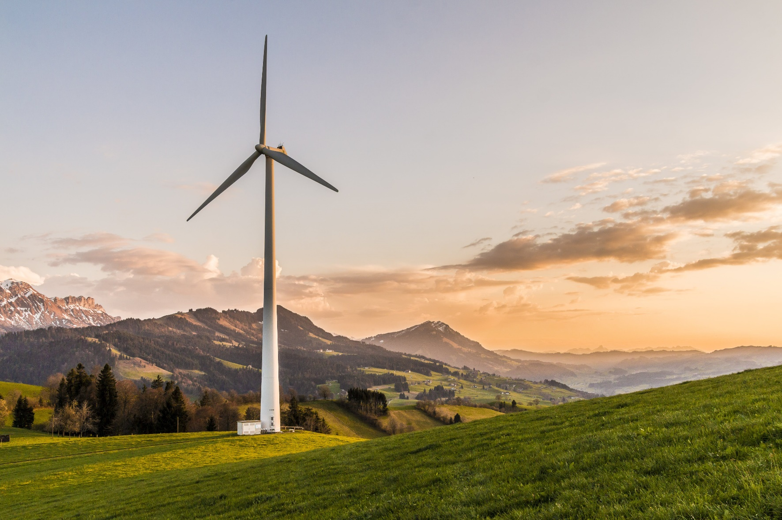
Topic 1
The three pillars of sustainable development
Photo courtesy: Pixabay (2017). https://www.pexels.com/photo/white-windmill-414837/

Slide 6
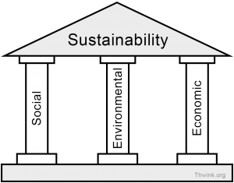
Three pillars of sustainable Development
The concept of sustainable development rests fundamentally, on three conceptual pillars. These pillars are “economic sustainability”, “social sustainability”, and ‘environmental sustainability.
Environmental challenges are often at the forefront of today’s discussions and they cannot be considered separately, as they are closely linked to economic and social challenges.
Source Thwink organisation. Website. :https://www.thwink.org/sustain/glossary/ThreePillarsOfSustainability.htm

Slide 7
Three pillars of sustainable Development
Almost everything that man does or intends to accomplish on Earth has an impact on society, the economy, the environment, and even the survival and well-being of the human race.
The interconnectedness of the pillars supports the argument that, when the concepts contained in the three spheres of sustainability are applied well to real world situations, everybody wins because natural resources are preserved, the environment is protected, the economy booms and is resilient, social life is good because there is peace and respect for human rights (Mensah, 2019).

Slide 8
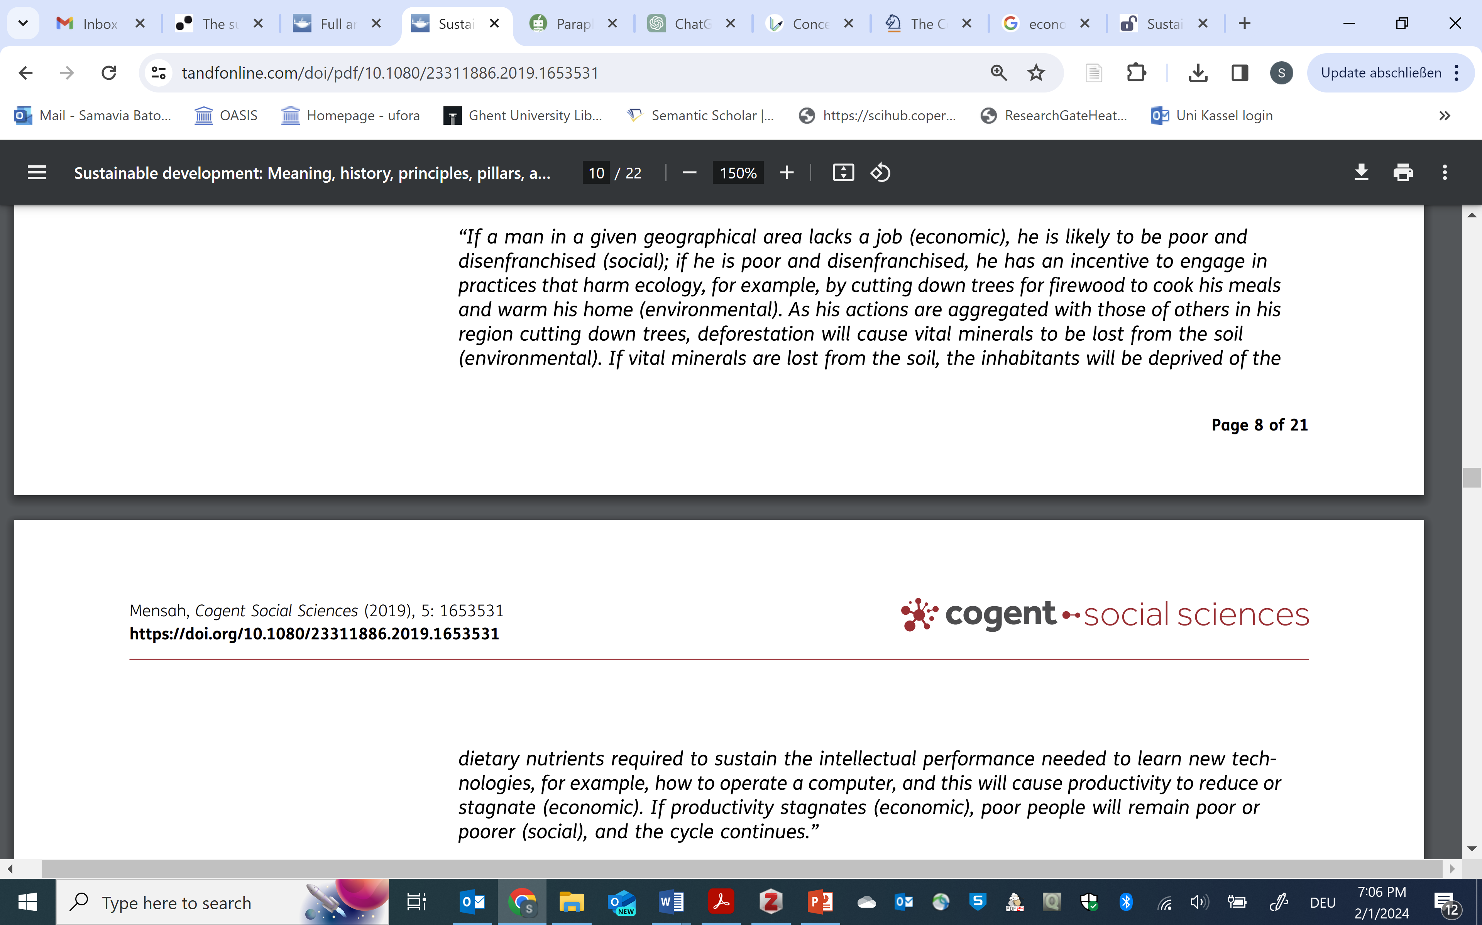
Relationships among social, environmental and economic sustainability
Source: Mensah, 2019

Slide 9
1. Economic sustainability
In the past, economists have overemphasized the market's ability to distribute resources effectively because they assumed that there will always be an infinite supply of natural resources.
Generally, three main activities that are carried out in an economy are production, distribution and consumption. These puts disproportionate emphasis on economic growth, overshadowing critical cost components such as the repercussions of resource depletion and environmental pollution. The escalating demand for goods and services drives market dynamics and leads to an inadvertent disregard for the adverse environmental impacts, manifesting in destructive consequences for our ecosystem.

Slide 10
1. Economic sustainability
But it's now understood that not all natural resources are renewable or replenishable, and that they are not endless.
The natural resource base has been overstretched by the expanding economic system, leading to a reexamination of the conventional economic theories.
Economic sustainability, therefore, requires that decisions are made in the most equitable and fiscally sound way possible, while considering the other aspects of sustainability (Zai & Chang, 2019).

Slide 11
1. Economic sustainability
Economic sustainability thus revolves around the following fundamentals:
1. Effective management of resources that meets the needs of the current generation without compromising the needs of the current generation.
2. Finding effective solutions for hunger and poverty in the world in environmentally sound ways.
3. Attaining economic growth which is sustainable and simultaneously improves our quality of life and environment

Slide 12
2. Social sustainability
Social sustainability encompasses notions of equity, empowerment, accessibility, participation, cultural identity and institutional stability. The objective of social sustainability is to secure people's socio-cultural and spiritual needs in an equitable way (Mansah, 2019).
The concept implies that people matter since development is about people.
It entails fostering the development of people, communities and cultures to help achieve meaningful life, drawing on proper healthcare, education gender equality, peace and stability across the globe.

Slide 13
2. Social sustainability
It entails fostering the development of people, communities and cultures to help achieve meaningful life, drawing on proper healthcare, education gender equality, peace and stability across the globe.
Issues such as human rights, gender equity and equality, public participation and rule of law also falls under the domain of social sustainability.
One of the key components of the social pillar is ensuring access to education, healthcare, and basic amenities for all.

Slide 14
3. Environmental sustainability
Environmental sustainability relates to ecosystem integrity and carrying capacity of natural environment.
The principle states that natural resources should not be taken faster than they can be replenished, and waste should not be discharged faster than it can be absorbed by the ecosystem. This is because the earth systems have limits or boundaries within which equilibrium is maintained.

Slide 15
3. Environmental sustainability
It focuses on the following important questions (Fischer et al., 2023):
For how long will this environment be able to satisfy our needs and wants?
What can we do to increase this environment’s productivity to fulfill our needs without harming it?
What can we do to improve environment’s resilience? Resilient environments are more stable, thus serving our needs better.
How long will this environment need to regenerate before we can come back and consume from it again?

Slide 16
Fusion of three pillars
The origins of the ‘three-pillar’ paradigm have been variously attributed to the Brundtland Report, Agenda 21, and the 2002 World Summit on Sustainable Development.
These were developed in order to have an ‘integrated’ approach to development and also in recognition of the fact that issues pertaining to one pillar cannot be addressed in isolation to the other two pillars.

Slide 17
Fusion of three pillars
Although the ‘three pillars’ have become commonplace throughout the literature, they are not universal. Some works consider additional pillars such as institutional, cultural and technical (Pervis et al., 2019).

Slide 18
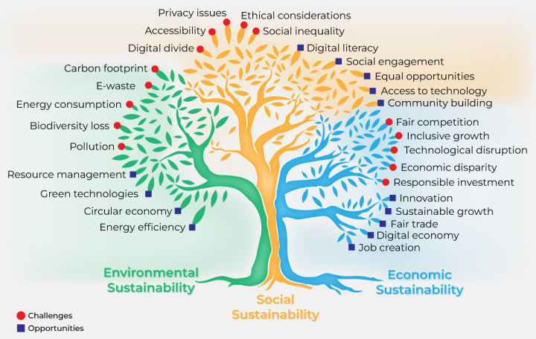
Fusion of three pillars
Source: Antonio Grasso

Slide 19
Two schools of thought (Purvis et al., 2019)
1. Three pillars as three distinct perspectives: These pillars should be managed independently of each other to retain the disciplinary distinction.
2. Three pillars as one system: Although each pillar has a goal of its own, the interactions of these systems must be managed to meet the goals of sustainable development. Each pillar strengthen and enhance each other. Focus is to “integrate”, “balance”, and “reconcile” the three pillars.

Slide 20
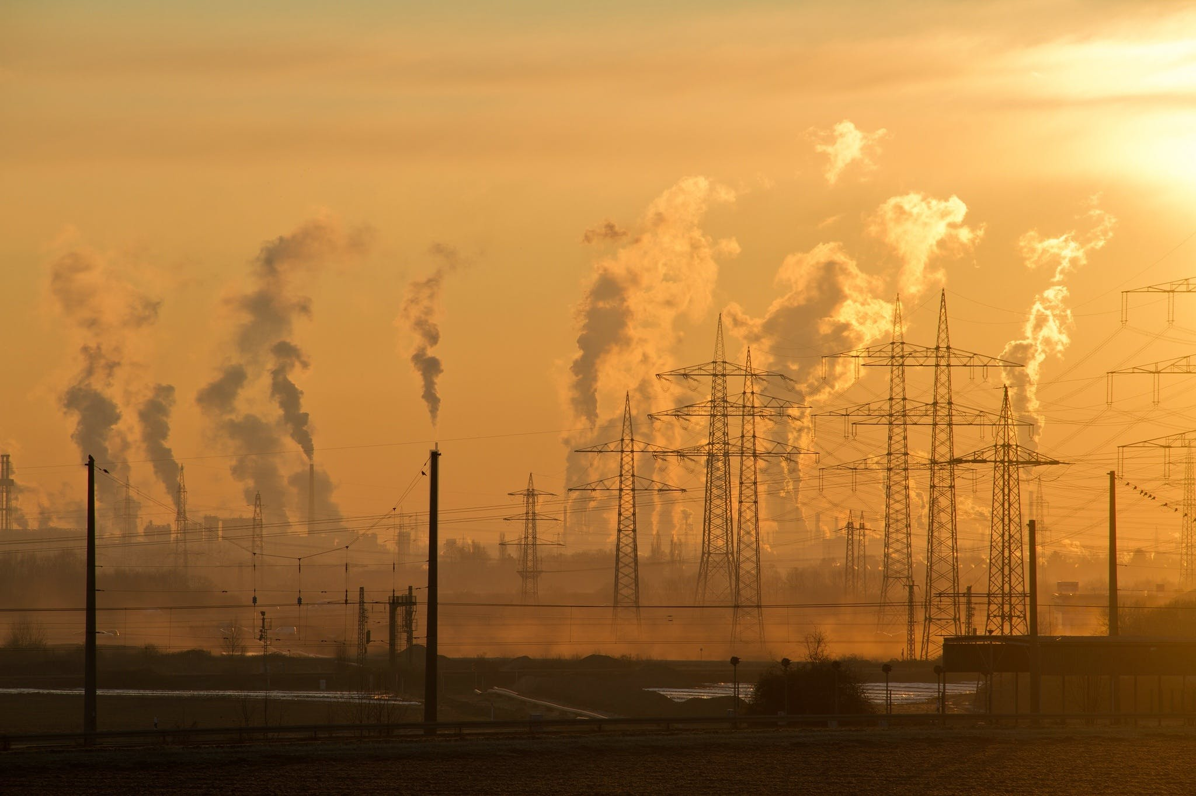
Topic 2
Principles of sustainable development
Photo courtesy: Pixabay (2016.). https://www.pexels.com/photo/electric-towers-during-golden-hour-221012/

Slide 21
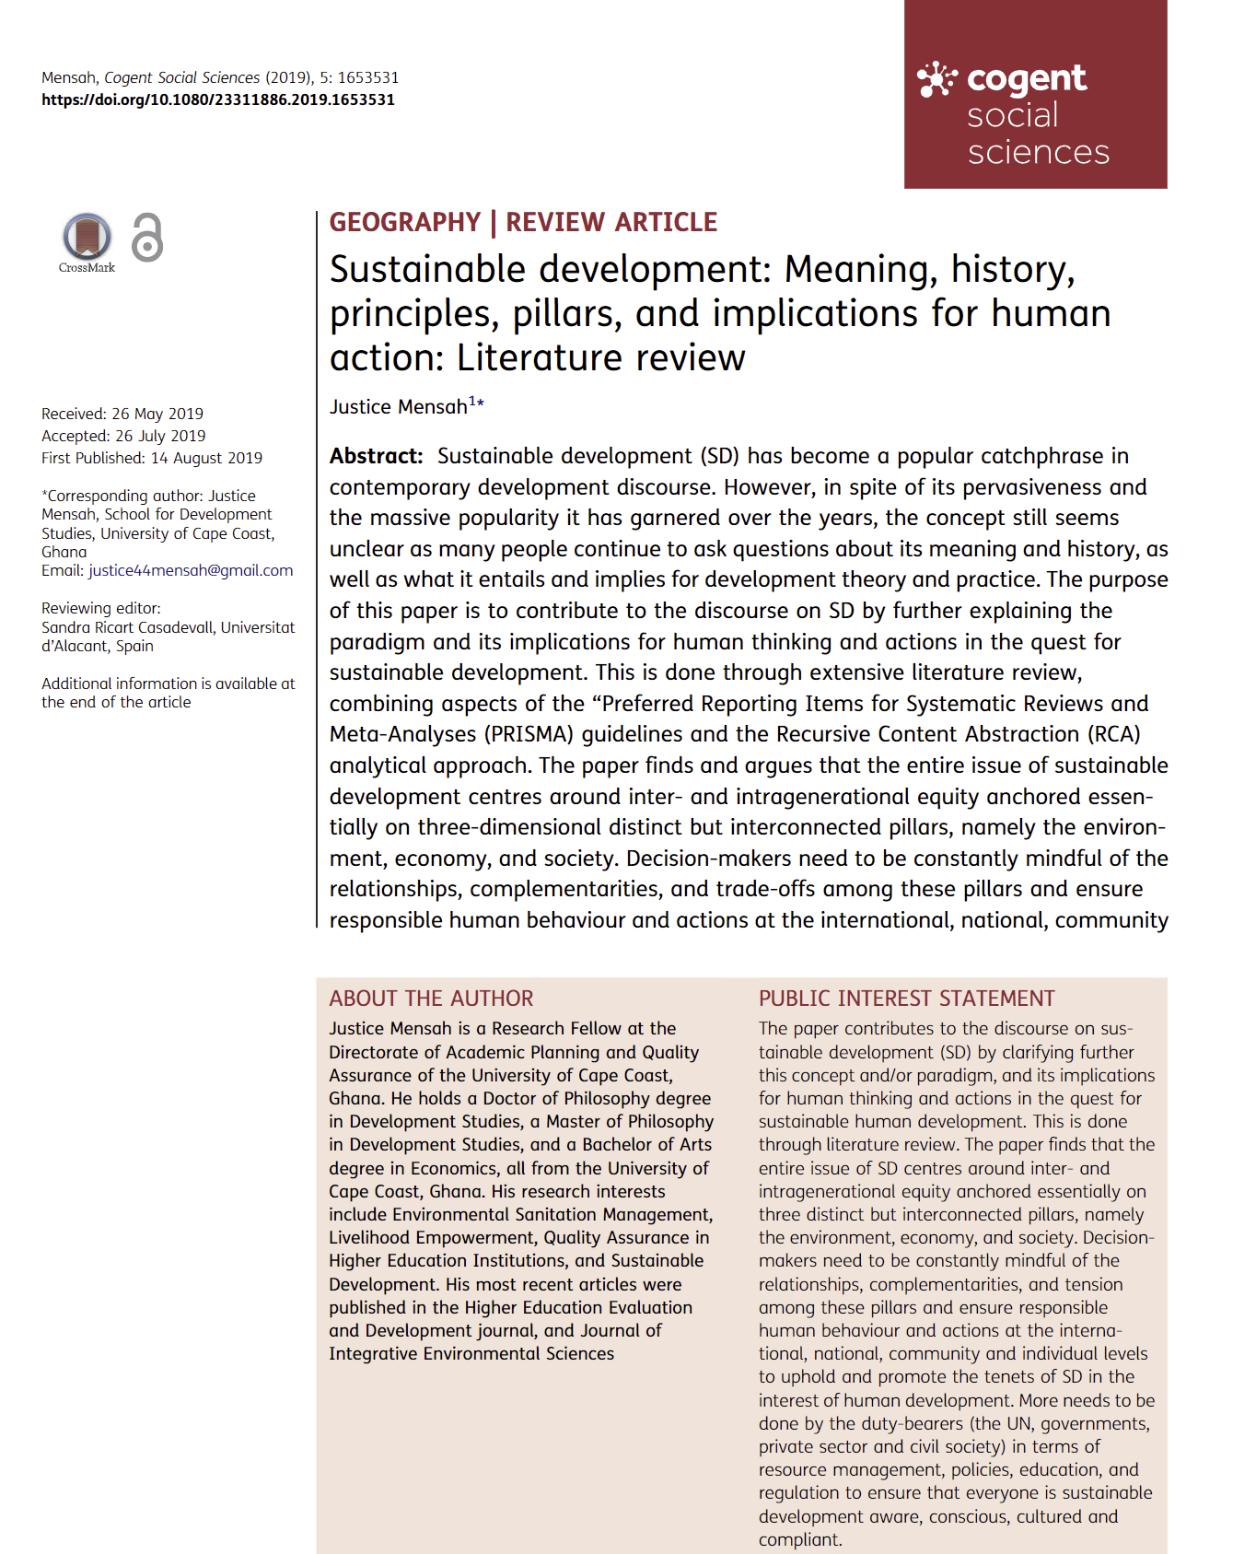
Principles of sustainable Development
Sustainable development aims to reconcile traditional socioeconomic goals with environmental quality and inter-temporal equity, rather than simply limiting economic growth.
There are five underlying principles that govern how this reconciliation can be achieved. These principles are adopted from Mensah (2019).

Slide 22
Principle # 1
Intergenerational equity
This concept asserts that each human generation has the right to profit from previous generations' resources as well as the duty to conserve them for future generations. This idea emphasizes the protection of biodiversity and renewable resources. This sustainable development principle is derived from the first and second principles of the Stockholm Declaration of 1972, which state that the environment is the resource base for the current generation's existence.

Slide 23
Principle # 2
Conservation of the environment
Conservation of the ecosystem is one of the key principles because The earth's finite resources cannot meet everyone's requirements. To ensure sustainable development, natural resources must be used within the earth's carrying capacity, as overexploitation has severe environmental impacts.
Sustainable development must not jeopardize the natural systems that support life on Earth, including the atmosphere, rivers, soils, and living organisms.

Slide 24
Principle # 2
It emphasizes responsible stewardship of natural resources, biodiversity conservation, and the reduction of environmental pollution.
Examples of environmental conservation:
- Shift to alternative sources of energy such as solar, instead of depending heavily on petroleum products, which will ultimately diminish.
- Establishing and managing protected areas, such as biosphere reserves, World Heritage sites etc.

Slide 25
Principle # 3
Population Management and Control
Human demands, such as those for food, clothes, and shelter, rise as a result of population expansion, but the world's resources cannot always keep up with the demand.
The pursuit of sustainable development is contingent upon the alignment of population trends with the evolving capacity for productivity within the environment.

Slide 26
Principle # 3
While humans are ultimately responsible for taking care of the environment, the principles focuses on the need to develop human knowledge and skills needed to develop a positive attitude towards the environment. This can be done through education and training.

Slide 27
Principle # 4
Participatory approach to sustainable development
Sustainable development cannot be achieved via the efforts of a single individual or group. This is a community obligation that demands cooperation from all individuals and relevant institutions.
The principle of participation and engagement in sustainable development recognizes the importance of inclusivity, empowerment, and collaboration. By involving stakeholders at all levels, sustainable development endeavors are more likely to be contextually relevant, socially accepted, and successful in achieving their intended goals.

Slide 28
Principle # 4
The participation of all relevant stakeholders also ensures that:
  local knowledge and wisdom is incorporated into the development plans.
  The decision-making processes are open and transparent.
  It contributes to the empowerment of local communities.
  Conflicts are minimized and solutions are accepted to all parties involved.

Slide 29
Principle # 5
Progressive social traditions, customs and political culture
To promote sustainable development, it is crucial to build and uphold progressive traditional and political cultures that not only unite society but also prioritize environmental conservation.
This will ensure a change in personal and community attitutde towards the environment.

Slide 30
References
Zhai, T. T., & Chang, Y. C. (2019). Standing of environmental public-interest litigants in China: Evolution, obstacles and solutions. Journal of Environmental Law, 30, 369–397. doi:10.1093/jel/eqy011.
Grasso, A. 2023. LinkedIn. https://www.linkedin.com/pulse/seamless-fusion-environmental-social-economic-digital-antonio-grasso/
Fischer, M., Foord, D., Frecè, J., Hillebrand, K., Kissling-Näf, I., Meili, R., Peskova, M., Risi, D., Schmidpeter, R., & Stucki, T. (2023). The Concept of Sustainable Development. In M. Fischer, D. Foord, J. Frecè, K. Hillebrand, I. Kissling-Näf, R. Meili, M. Peskova, D. Risi, R. Schmidpeter, & T. Stucki (Eds.), Sustainable Business: Managing the Challenges of the 21st Century (pp. 17–27). Springer International Publishing. https://doi.org/10.1007/978-3-031-25397-3_2.
Purvis, B., Mao, Y., & Robinson, D. (2019). Three pillars of sustainability: In search of conceptual origins. Sustainability Science, 14(3), 681–695. https://doi.org/10.1007/s11625-018-0627-5

Slide 31
Further Resources for teachers
Mensah, J. (2019). Sustainable development: Meaning, history, principles, pillars, and implications for human action: Literature review. Cogent Social Sciences, 5(1), 1653531. https://doi.org/10.1080/23311886.2019.1653531.
Purvis, B., Mao, Y., & Robinson, D. (2019). Three pillars of sustainability: In search of conceptual origins. Sustainability Science, 14(3), 681–695. https://doi.org/10.1007/s11625-018-0627-5

Slide 32
Notes for Teachers
Slide 4: Ask students about their own definition of Sustainable Development. Write key words and phrases mentioned in each definition, on the board. Conclude by highlighting the multifaceted nature of Sustainable Development. There’s no simple and easy way to describe sustainable development, as it involves a complex interplay of different factors and disciplines.
Slide 18: The integration of sustainable development's three pillars—economic, social, and environmental—is the foundation of a comprehensive strategy to tackling global concerns. Sustainable development aims to create long-term well-being for current and future generations by integrating economic success, social equality, and environmental care. This fusion emphasizes the pillars' interconnectedness, highlighting the importance of inclusive economic growth, fair social advancement, and environmental protection.

