Slide 1

Climate Change & Sustainable Development
Photo by Prado on Unsplash
Session 3: Introduction to Sustainable Development Goals
Teacher’s name, email and date of session

Slide 2
Course outline
Part 1: Climate Change and Sustainable Development: An Introduction
Part II: Society, Sustainable Development and Climate Change
Part III: Environment and Sustainable Development
Part IV: Climate Change, Economy and Sustainable Development Interface
Part V: Action for Sustainable Development

Slide 3
Agenda
Introduction to Sustainable Development Goals
  Brief introduction to Millennium Development Goals and Sustainable Development Goals
  SDG Global performances
  Pakistan’s performance on SDGs

Slide 4
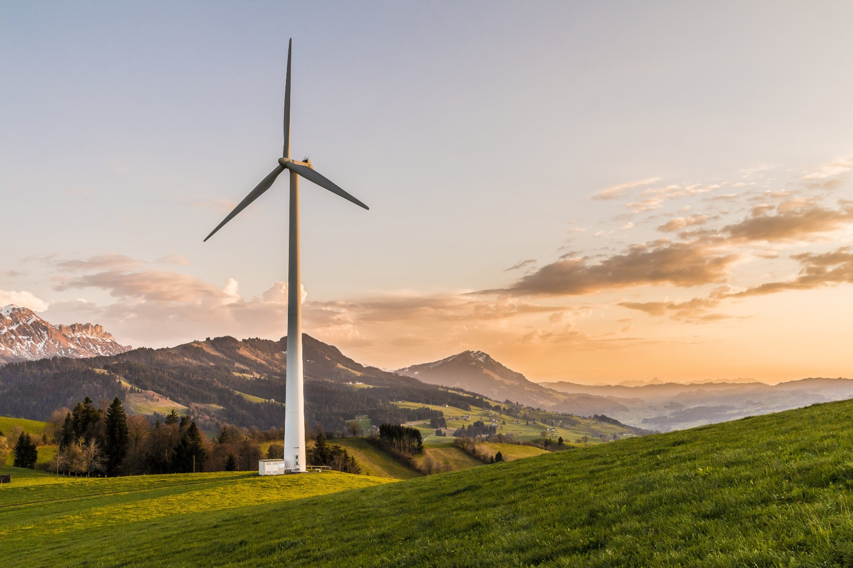
Topic 1
Brief Introduction to the MDGs and SDGs
Photo courtesy: Pixabay (2017.: https://www.pexels.com/photo/white-windmill-414837/

Slide 5
Millennium Development Goals (MDGs)
In the year 2000, 189 nations signed the Millennium Declaration at the United Nations in New York, pledging to collaborate to create a safer, more prosperous, and equal world. The Millennium Development Goals are eight time-bound and quantifiable goals aimed at achieving the Declaration by 2015.
The MDGs comprised 8 goals and 18 targets and were primarily concerned with eradicating extreme poverty. Other targets were focused on education and health but all these goals were aimed at improving the quality of life for those of the poorest and least developed regions of the world.

Slide 6
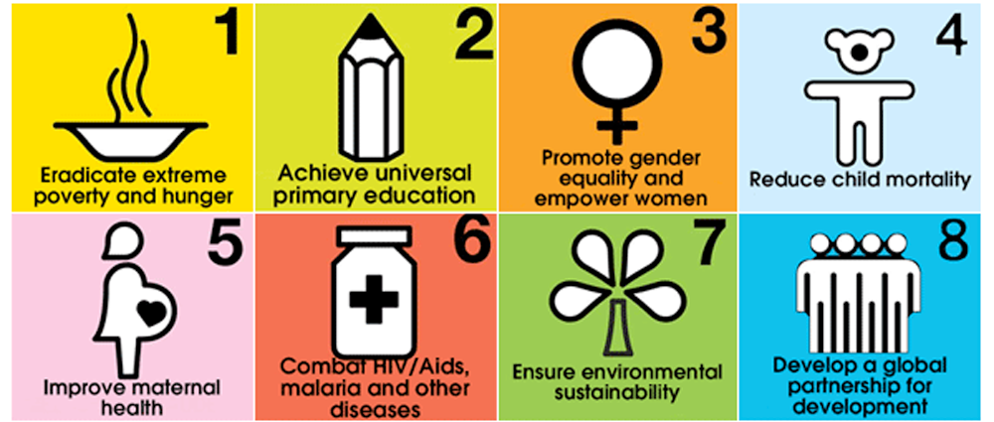
Millennium Development Goals (MDGs)
Source: United Nations. (2000). United Nations Millennium Declaration. Resolution 55/2. New York: United Nations.

Slide 7
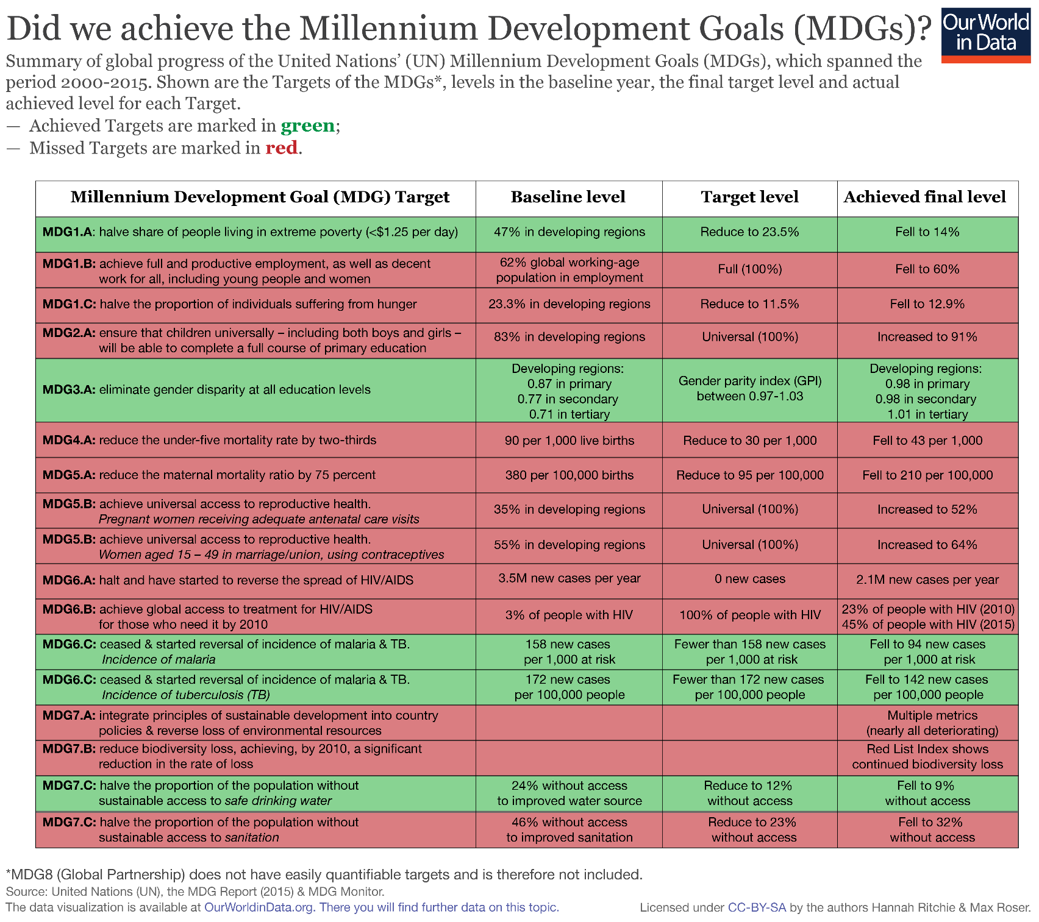
- Overall, the world achieved 3 and a half out of the 14 Targets:
  MDG Target 1.A halving the share of the world population living in extreme poverty
  MDG 3 closing gender disparity in education
  MDG Target 6.C on malaria and tuberculosis
  MDG 7 - achieved half of this goal

Slide 8
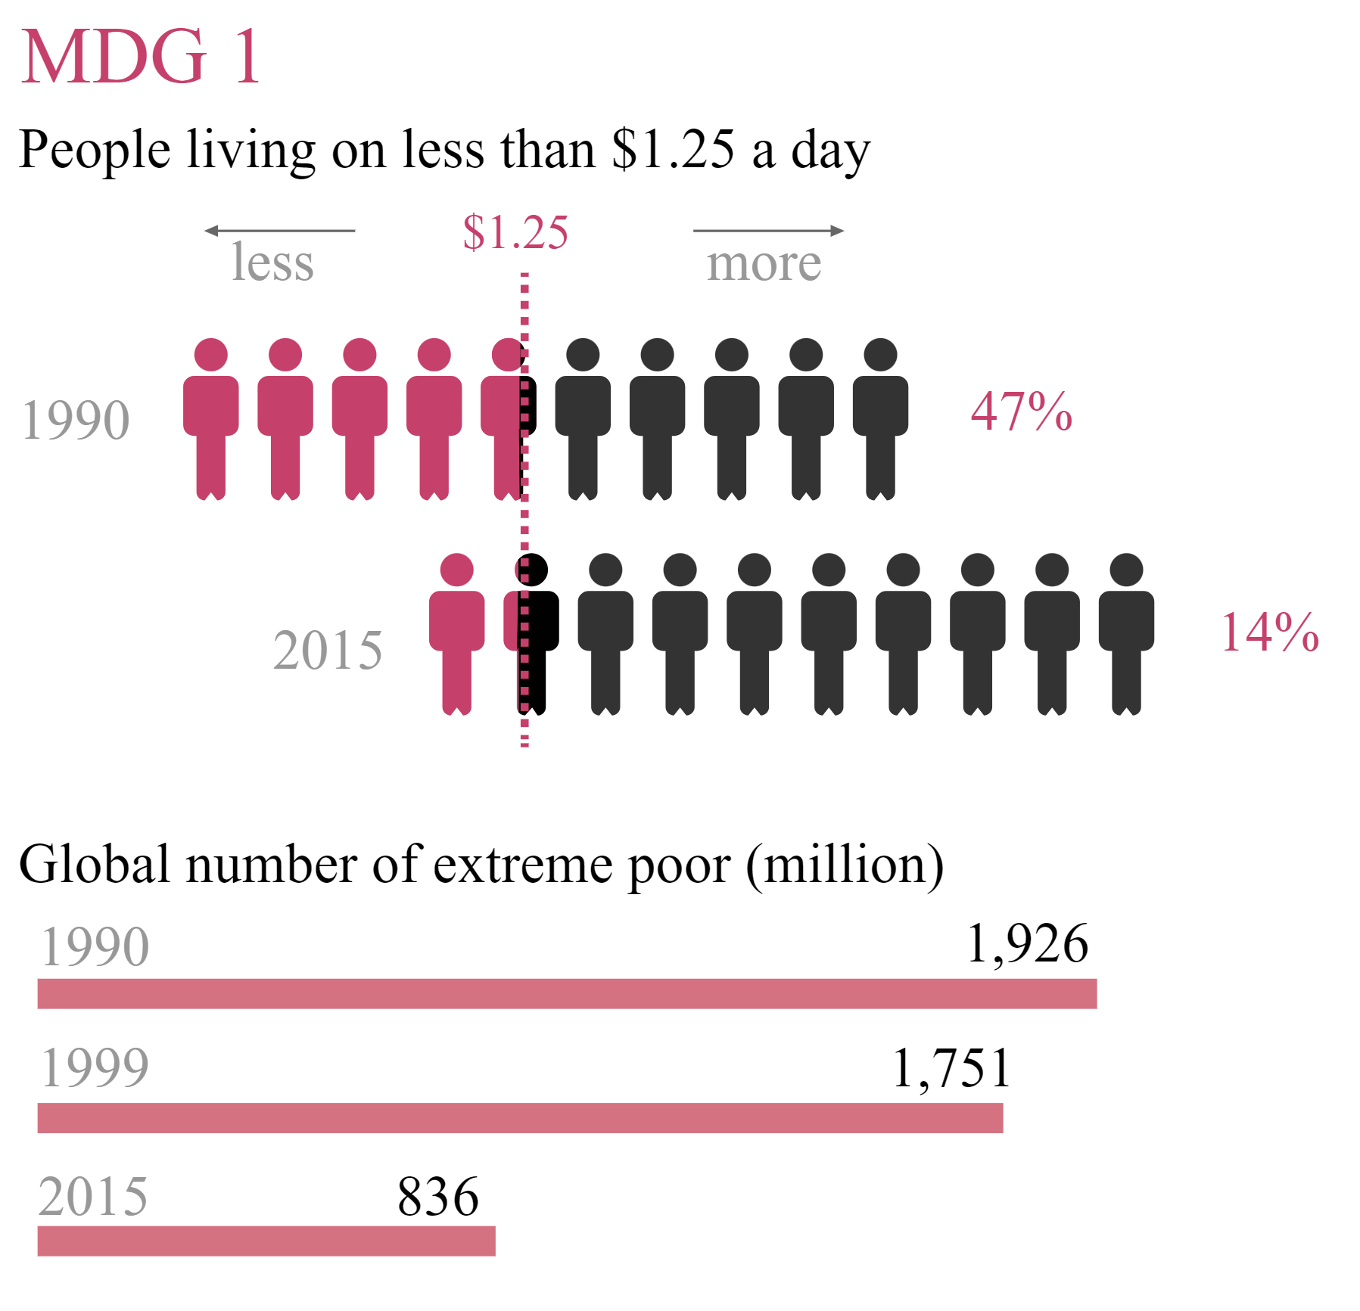
Major achievement: Poverty reduction
The number of people living on less than $1.25 per day has decreased from 1.9 billion in 1990 to 836 million in 2015. The decline was 14%, which even surpassed the target of 23.5%.
Source: Galatsidas et al. (2015)

Slide 9
From MDGs to SDGs (Battersby, 2017)
The Millennium Development Goals (MDGs) have significantly shaped both development and the conversation surrounding it but they drew a lot of criticism as well. For example:
- MDGs were developed in consultation with a few global experts, which is why they were not sufficiently universal in focus.
- The goals were not comprehensive and missed out on some of the key developmental challenges.
- MDGs reinforced a donor-centric view of development.
The gaps and criticism on the MDGs thus gave way to the Sustainable Development Goals (SDGs).

Slide 10
Sustainable Development Goals
In 2015, 193 nations committed to address global inequality, poverty, and climate justice. They planned to do this by collaborating on a sustainable development agenda, which included 17 goals and 169 targets.
The SDGs expanded the predominantly singular objective of the MDGs—i.e. the reduction of extreme poverty—to include four key dimensions: inclusive social development, inclusive economic development, environmental sustainability, and peace and security.

Slide 11
Sustainable Development Goals
It is a framework which promotes economic development and social progress in an environmentally sustainable manner taking ecological boundaries into account.
Sustainable Development Goals act as a guiding compass and a blueprint, steering our collective efforts and actions towards a more sustainable and inclusive future.
SDGs offer a more people-centred development agenda and are framed as “universally applicable”.
The 17 SDGs are interconnected, recognizing that actions in one area influence outcomes in others and that development must balance social, economic, and environmental sustainability.

Slide 12
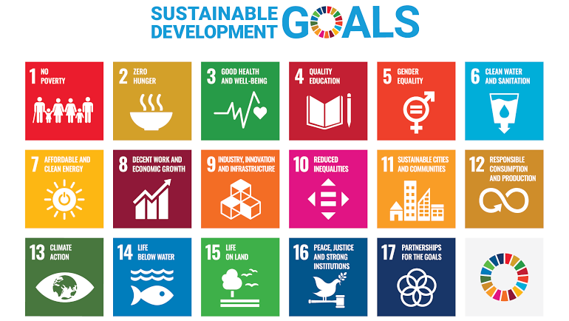
Source: United Nations

Slide 13
Legal status of SDGs
The SDGs are not legally binding; governments are under no duty to be sustainable or to protect resources for future generations. Instead, countries operate on a basis of healthy peer pressure.
The SDGs draw from various international agreements, aiming to enhance the implementation of existing international laws. For instance, SDG 8 aligns with ILO conventions, such as those against child and forced labor, reinforcing multilateral commitments. While not legally binding, SDGs do reinforce multilateral agreements.

Slide 14
SDG Targets
Each goal of the SDG comprises a set of targets that address various dimensions of sustainable development, such as social inclusion, economic growth, environmental conservation, and institutional development.
These targets are often numerical and are set within a timeframe. These targets consider the diverse circumstances of individual countries and are also helpful in measuring the progress of different countries and keeping accountability.
The targets are measured at the national level. This leaves leeway for differences across countries. Although objective 1.1 relates to severe poverty, which is presently defined as $1.25 per day, target 1.2 focuses on "national definitions". Switzerland and Kenya have significantly different national definitions of poverty, but under SDG 1 objectives, both are urged to reduce the number of persons afflicted by half.

Slide 15
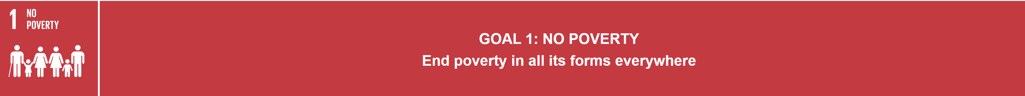
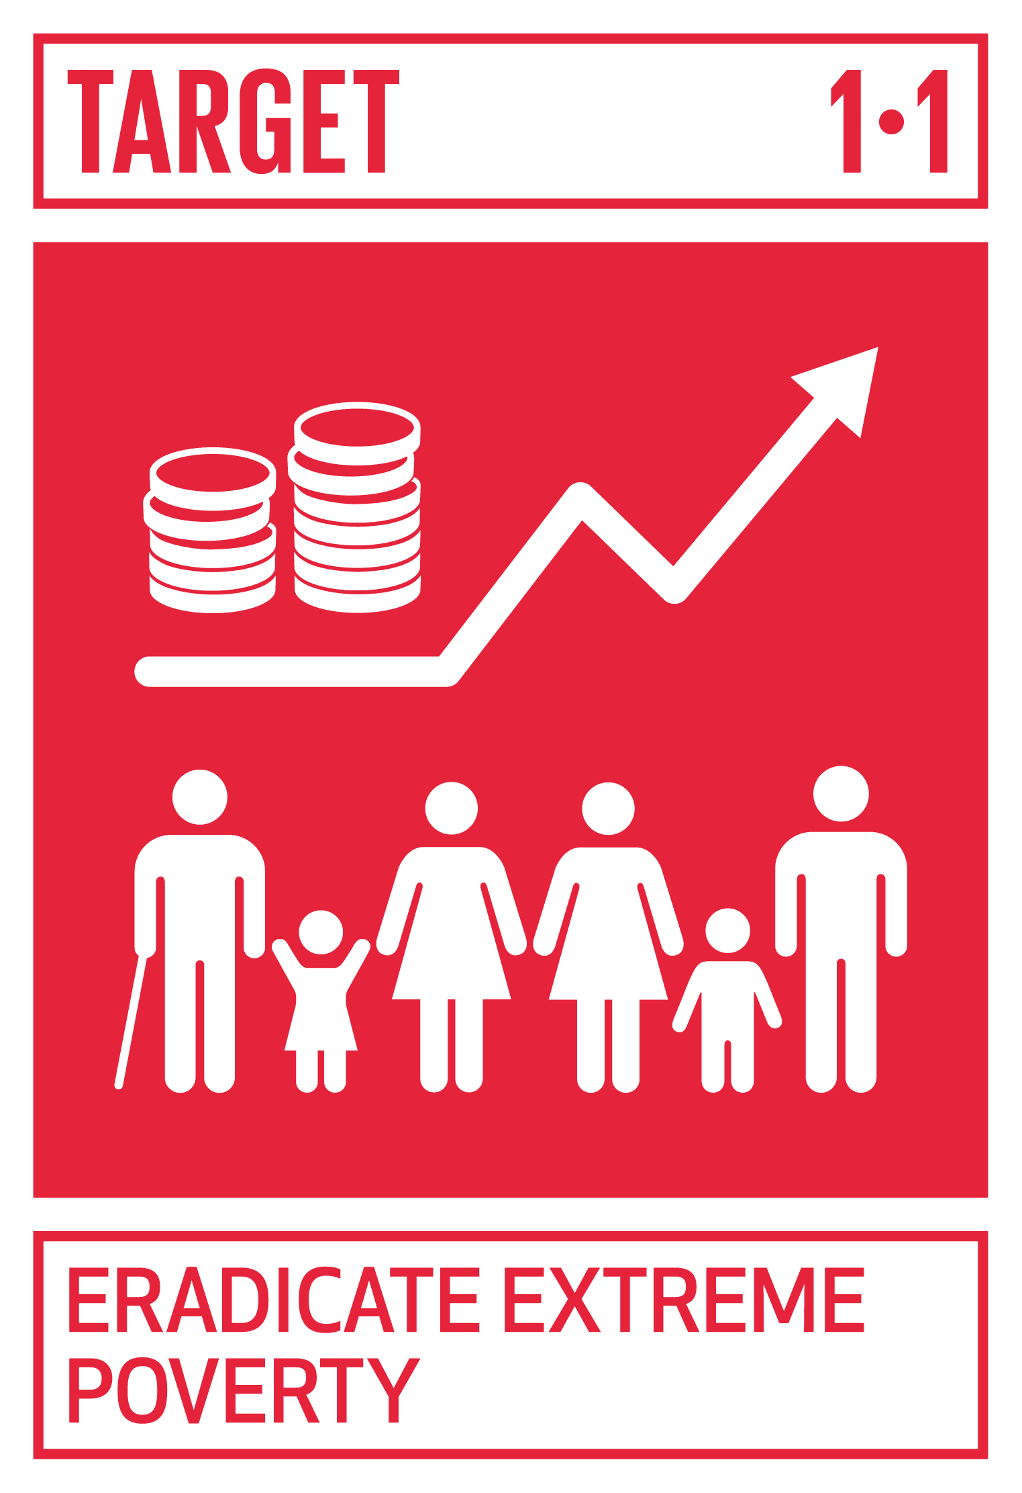
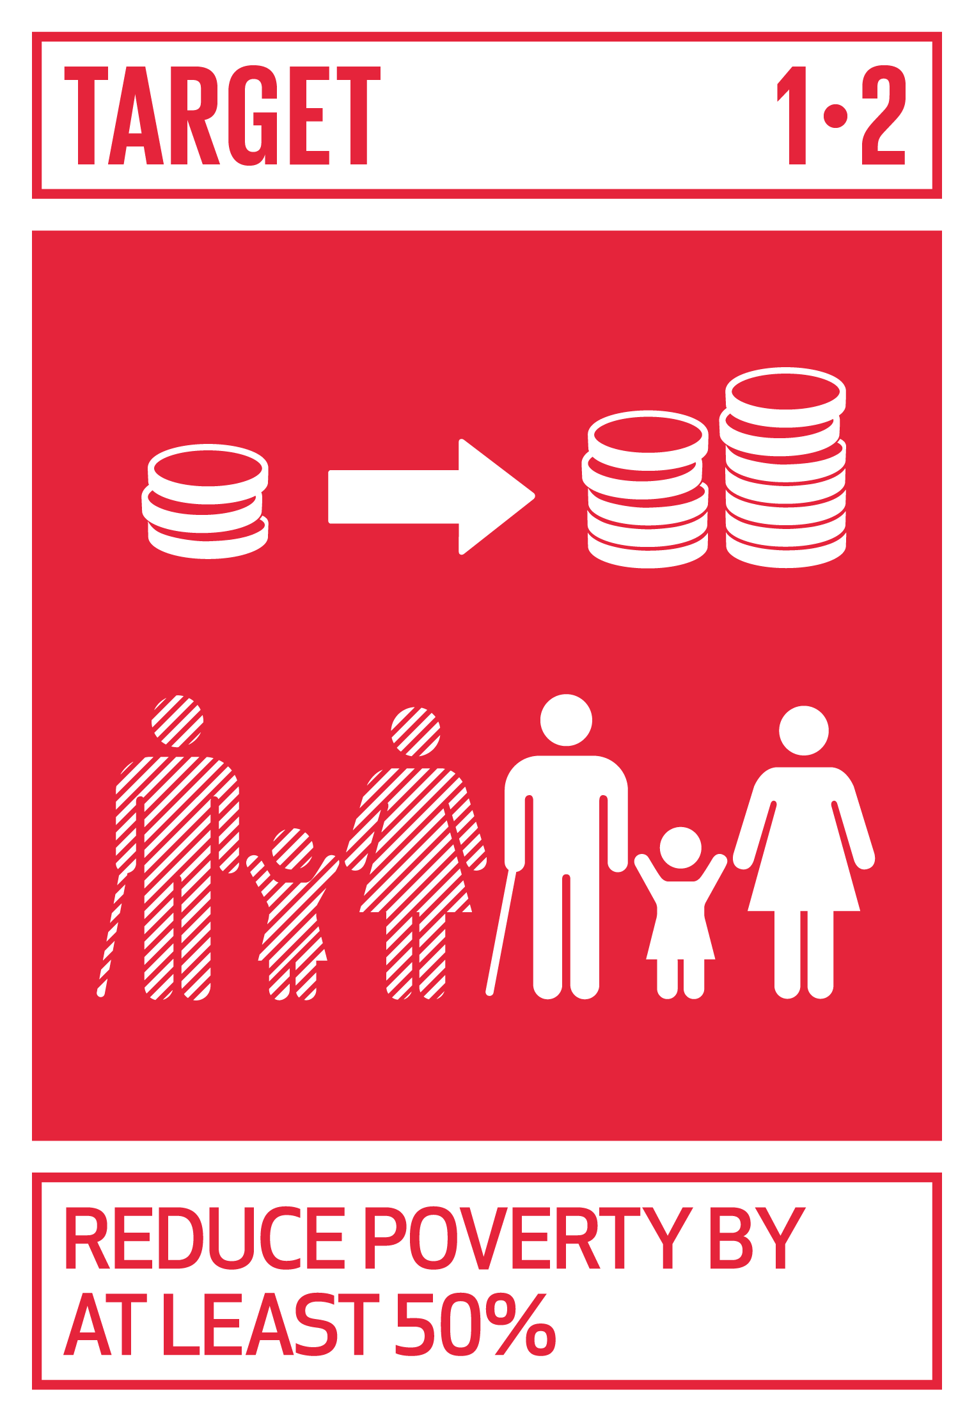
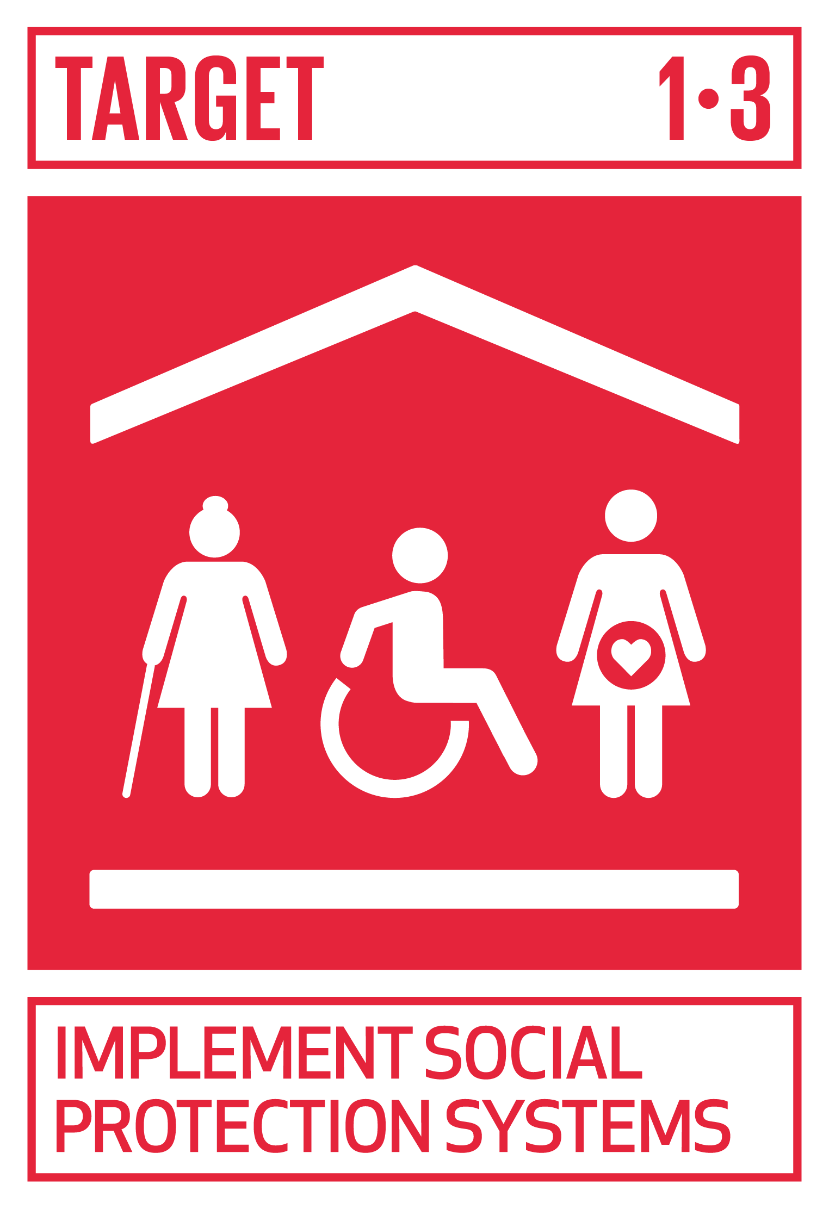
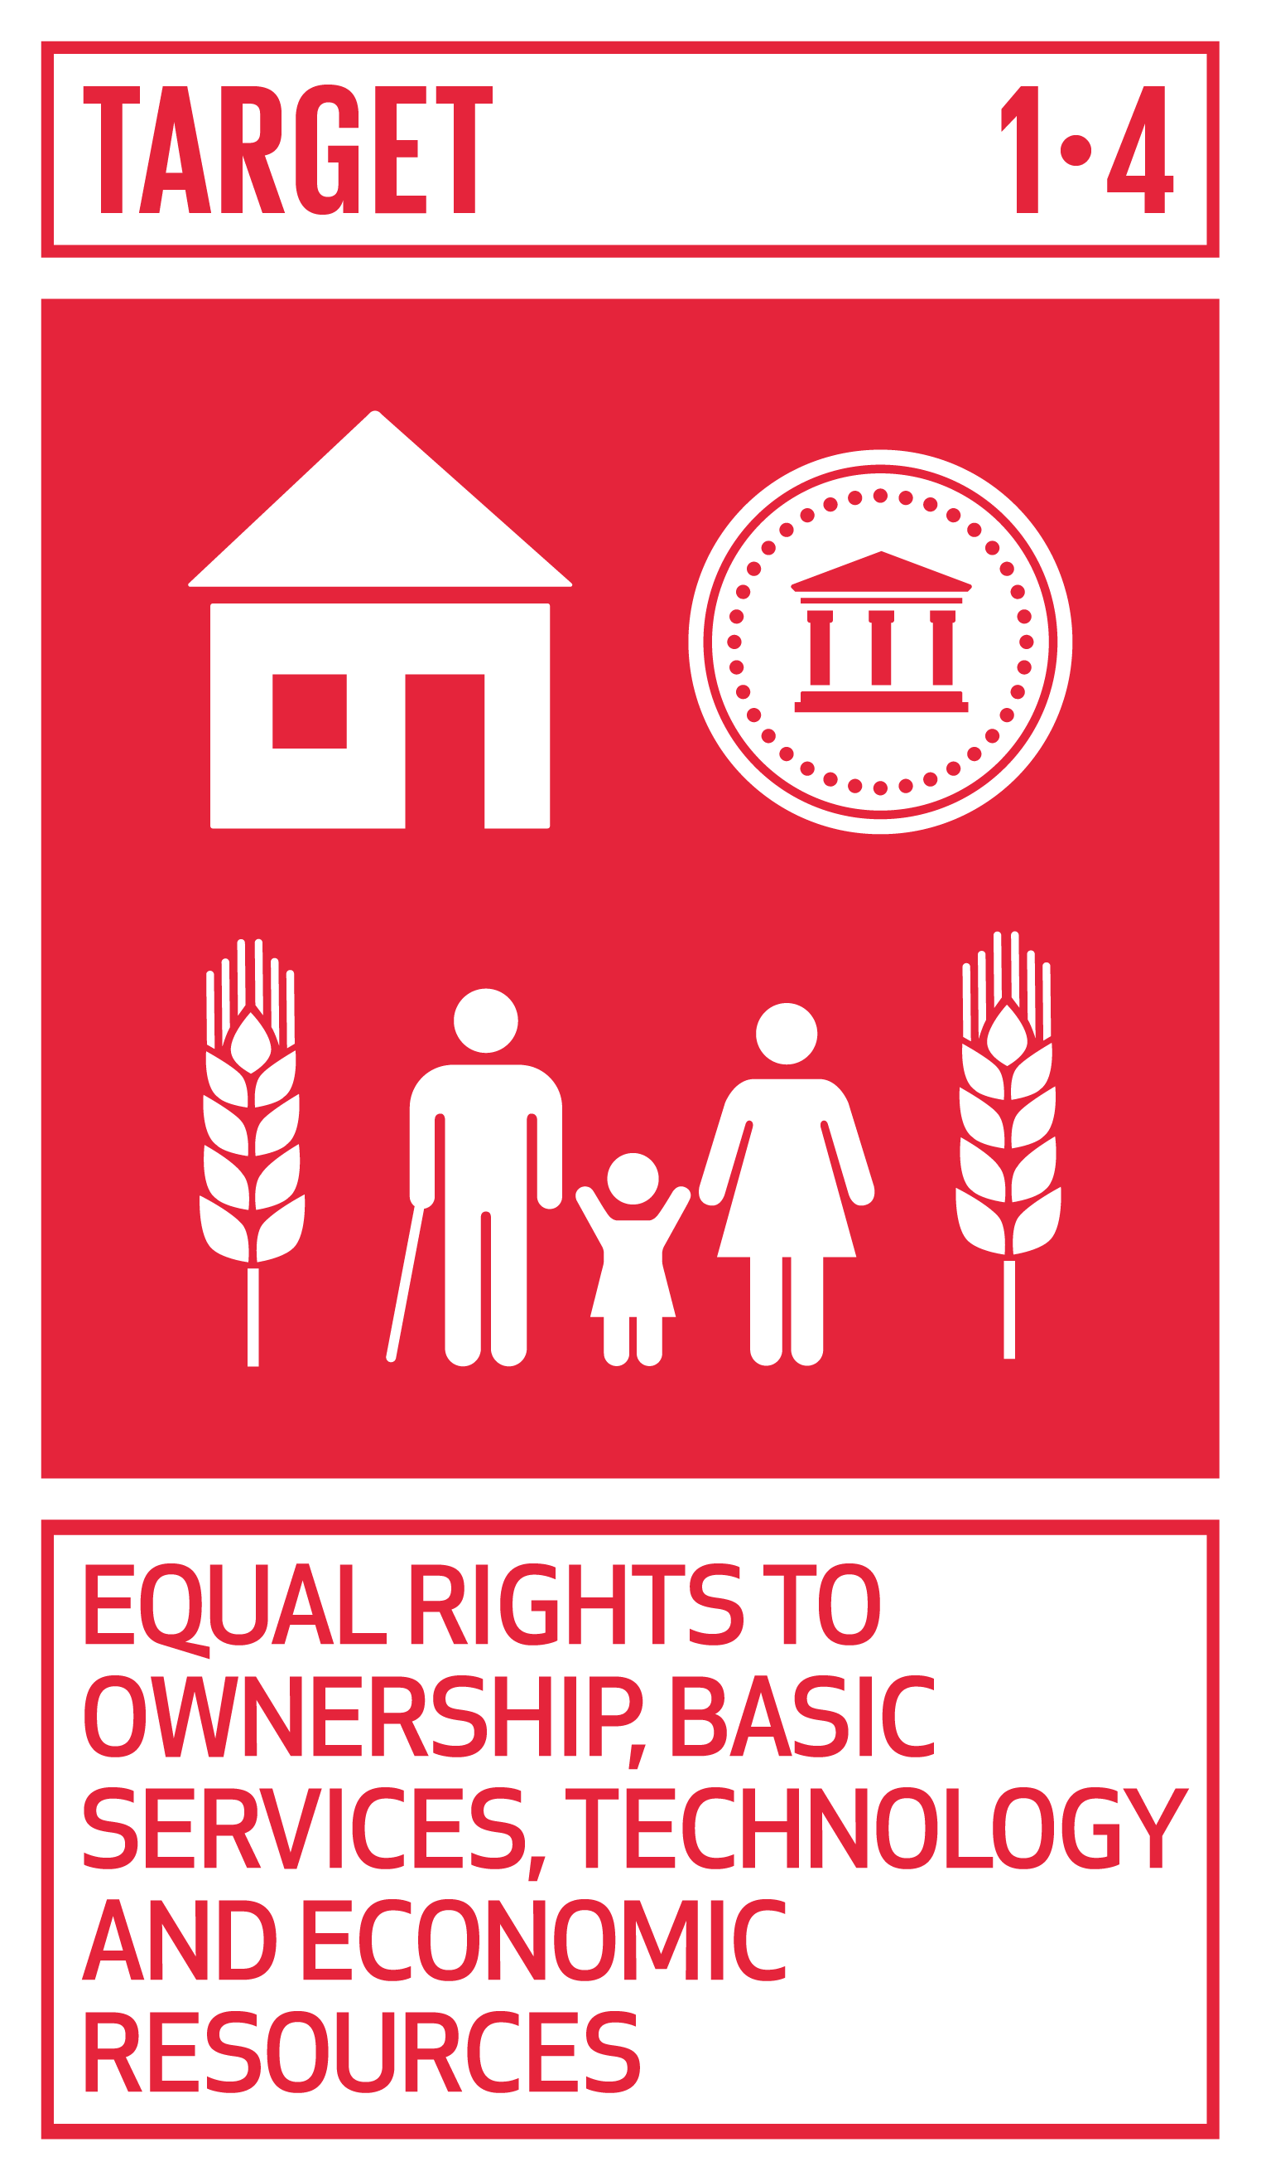
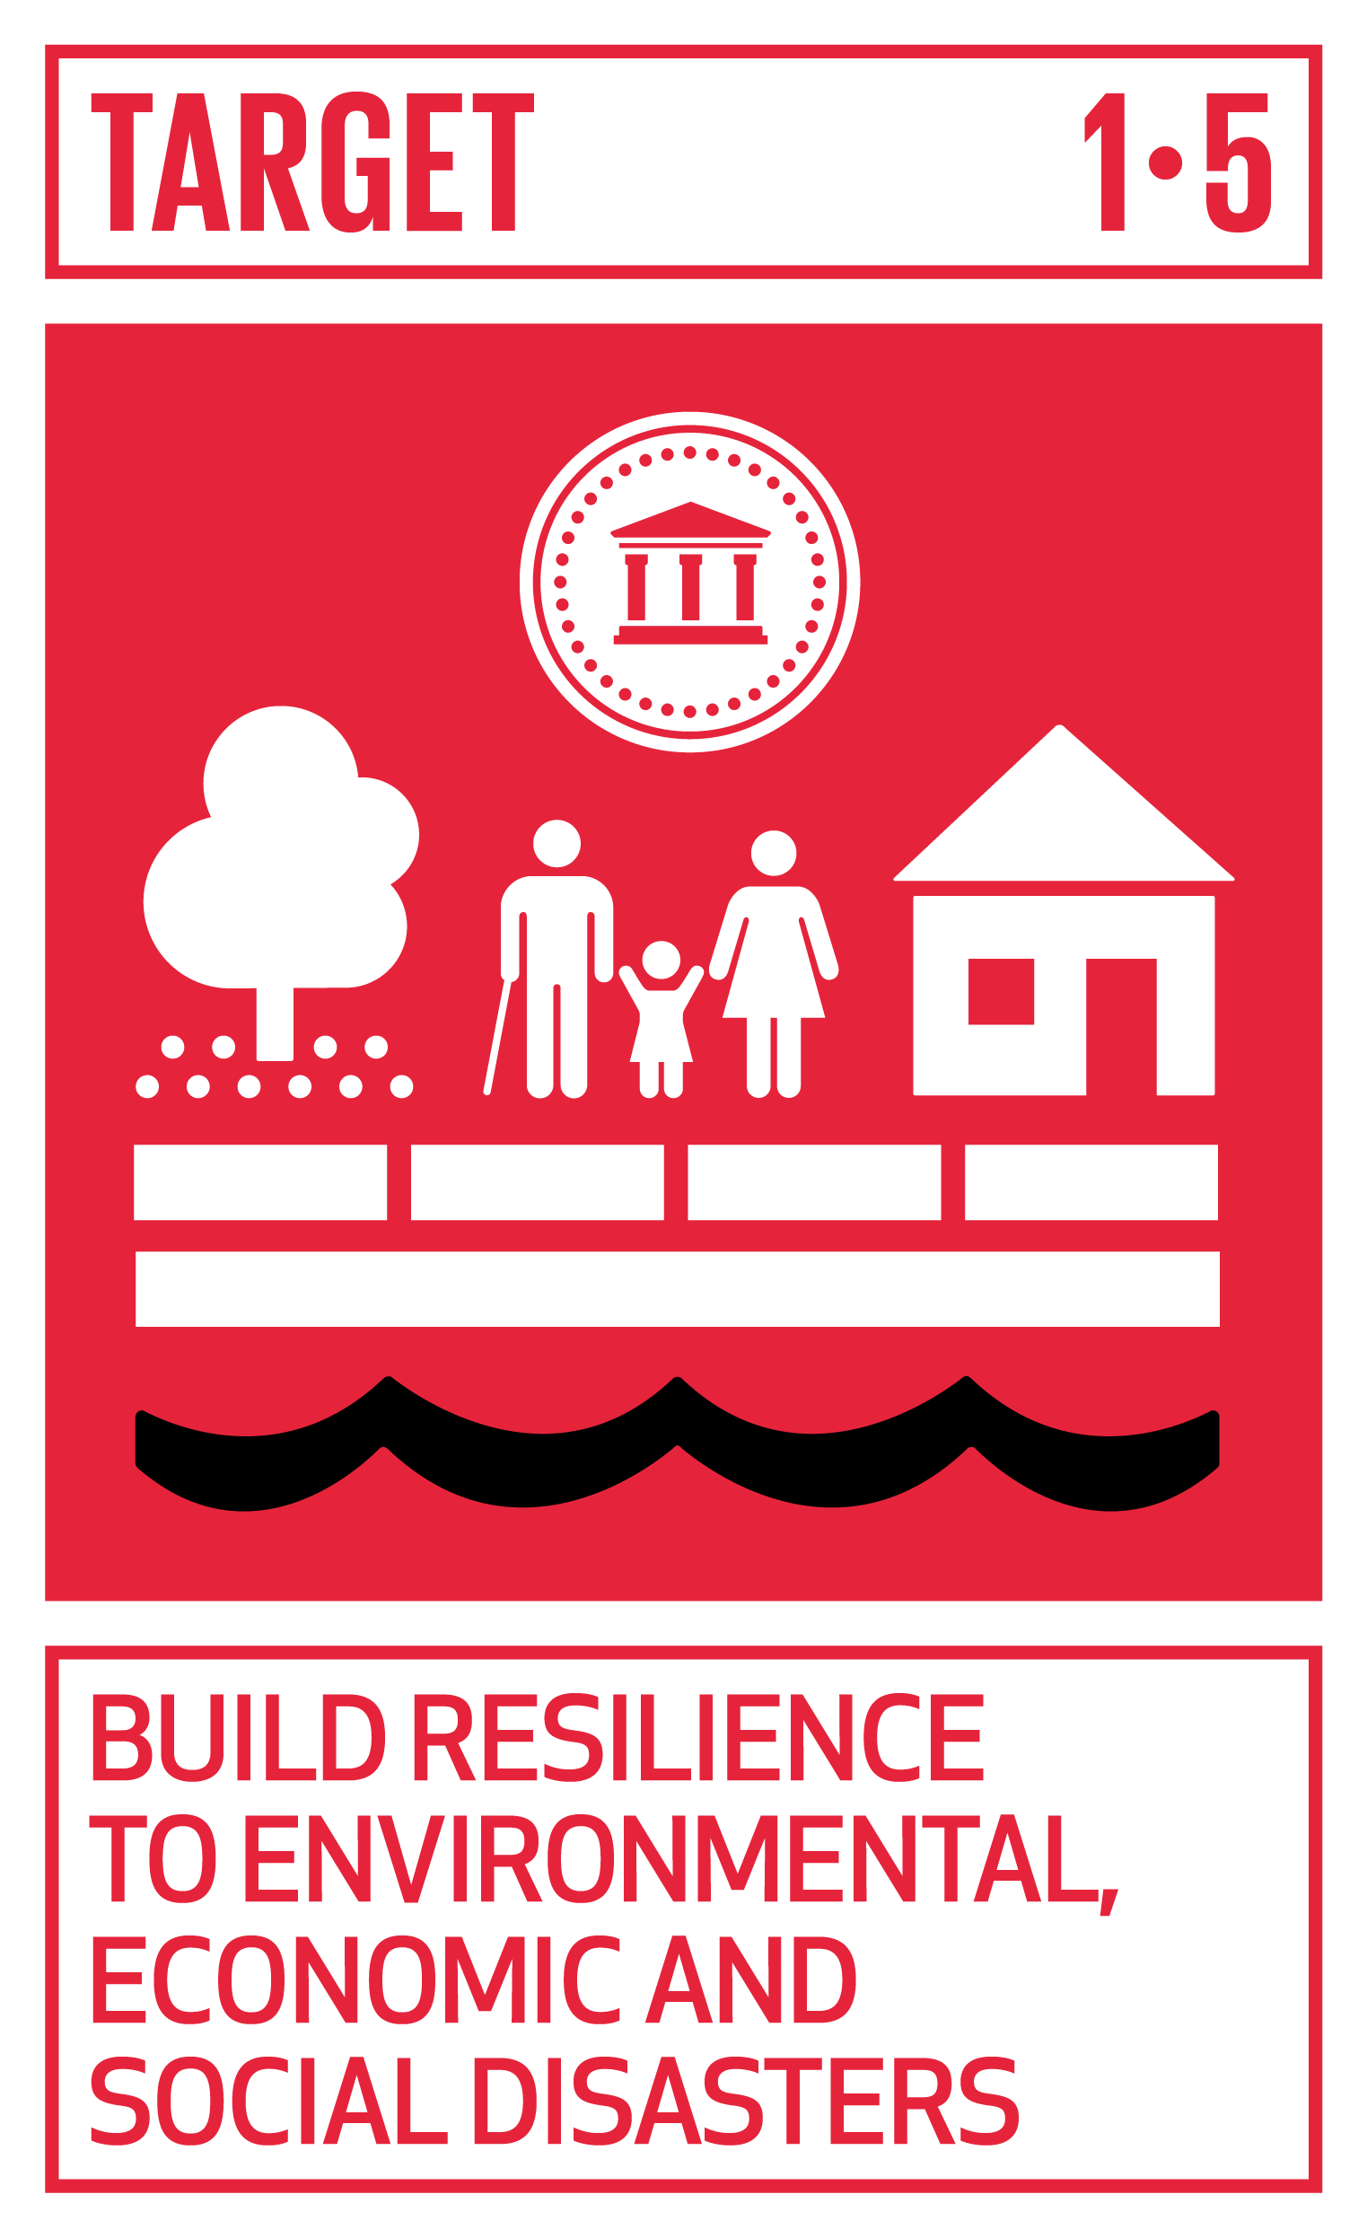
Source: European Comission. 2024.Website. https://knowsdgs.jrc.ec.europa.eu/sdg/1

Slide 16
SDG Indicators
Apart from 169 specific targets, there are 232 measurable indicators.
These indicators are built within the targets which help countries plan their policies, measure their progress, find gaps and report the results to the international community.
The indicators are generally framed around;
people (% of population etc.),
Policies (Govt spending on education % etc.),
production and consumption (green energy production % etc.),
and planets resources (conserve water etc.).

Slide 17
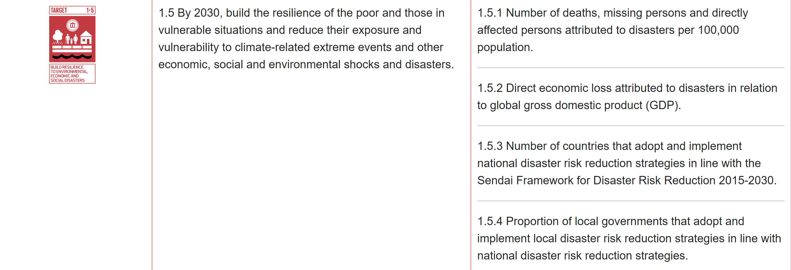
Targets
Indicators
Measurable indicators

Slide 18
What is the added value of the SDGs if many of its individual objectives and targets are already covered by other international agreements and are not new?

Slide 19
Value addition of SDGs
1. SDGs brought a shift in the international policy agenda, especially the agenda of climate change and inequality.
2. They catalyze change by promoting ongoing discussions and high-level political forums that apply peer pressure to nations, forcing them to execute required reforms.
3. SDG targets also promote a bottom-up approach by encouraging action by local actors.

Slide 20
How is SDGs agenda better than MGDs?
1. SDGs follow a more consultative process. It included national, regional, and global thematic consultations, consultations with CEOs from 300 major corporations, the scientific and academic community, 5000 civil society organizations, and 4.5 million respondents to the UNDP MyWorld online survey.
2. SDGs are far more universal and comprehensive, tackling a multitutde of developmental challenges.
3. The SDGs are framed around the broader concept of sustainable development and is not just an outcome of an international conference.

Slide 21
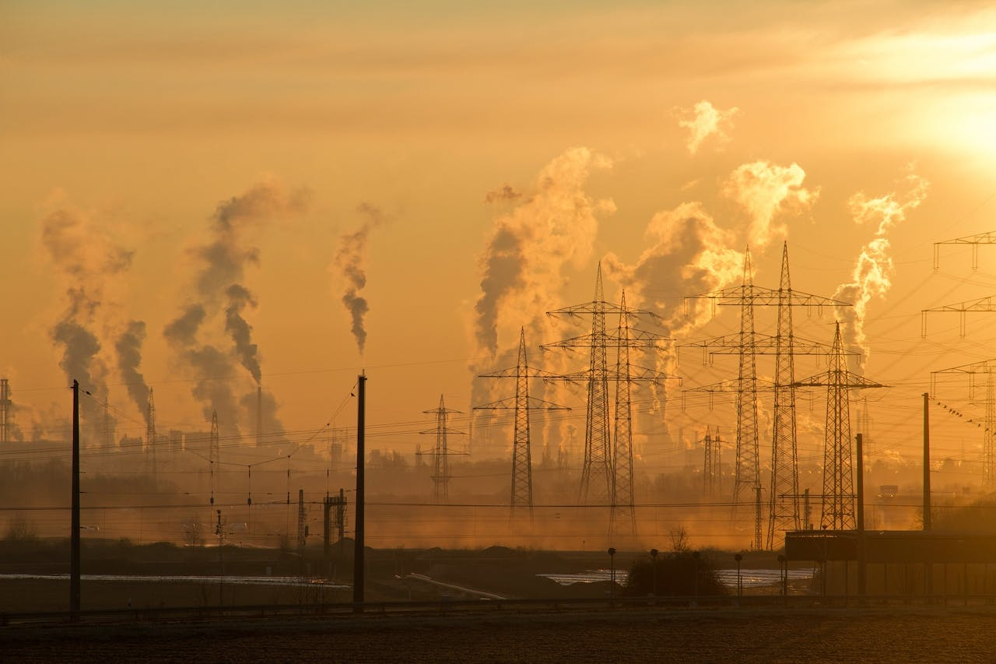
Topic 2
SDG Global performances
Photo courtesy: Pixabay (2016).: https://www.pexels.com/photo/electric-towers-during-golden-hour-221012/

Slide 22
Measuring the performance
An yearly report published under the title ‘Sustainable Development Report‘ provides an assessment of progress made towards the SDGs by all countries.
The Report includes the SDG Index, in which scores are presented on a scale of 0 to 100 and can be interpreted as a percentage towards optimal SDG performance.
The overall score measures the total progress towards achieving all 17 SDGs. The score can be interpreted as a percentage of SDG achievement. A score of 100 indicates that all SDGs have been achieved.

Slide 23
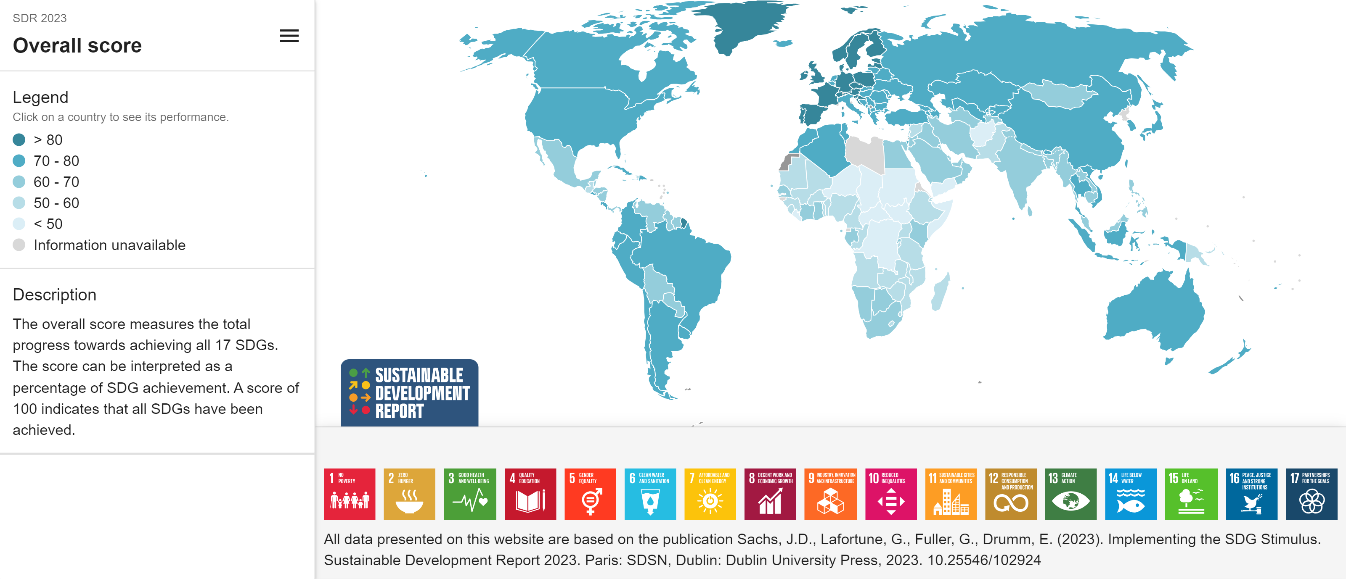
Where are the highest and lowest performing countries?

Slide 24
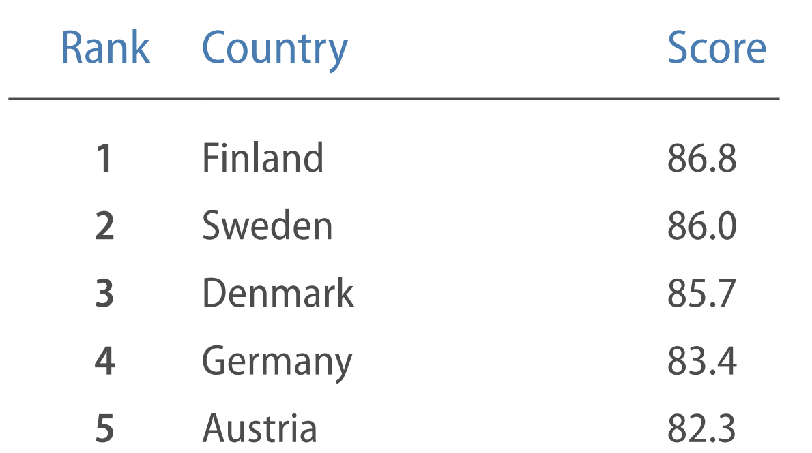
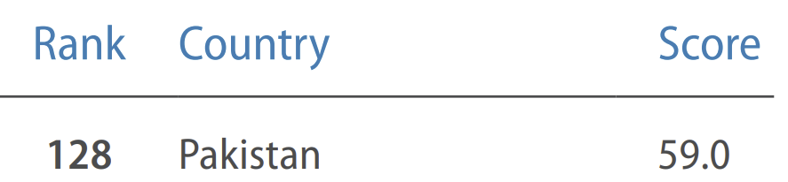
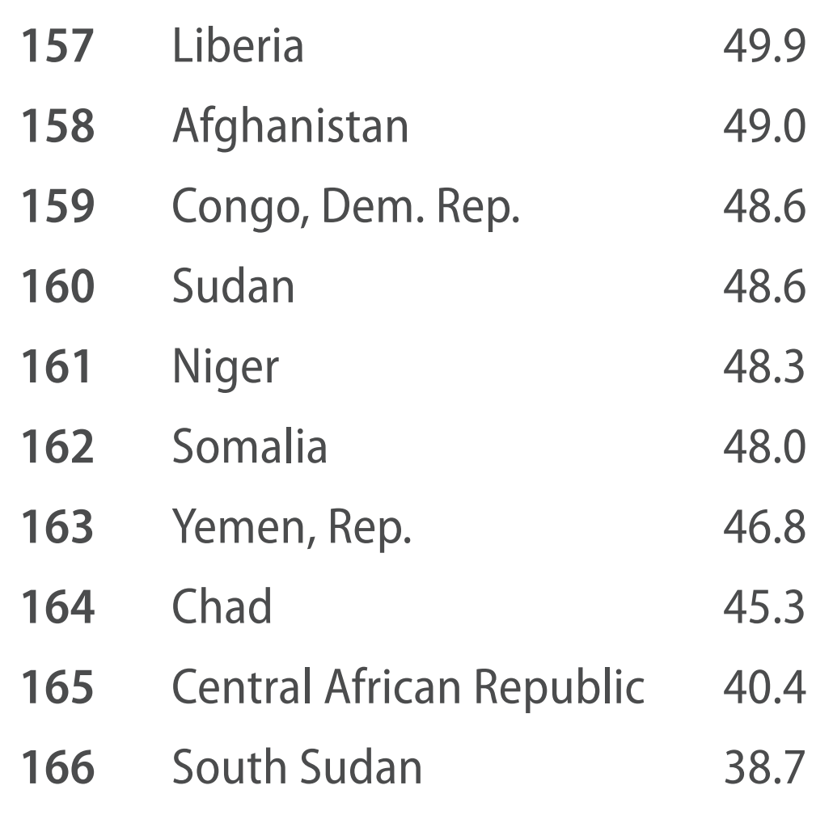
The world's top five countries in terms of SDG targets
The world’s last 10 countries in terms of SDG targets

Slide 25
Class Activity: SDG Dashboard game
The SDG Trend Dashboards indicate whether a country is on track to achieve the goals by 2030, based on past performance (see next slide).
  Trends are calculated for each indicator and are denoted by different colored arrows.
  Colored circles represent the level of SDG achievement.
1. Colored copies of the ‘2023 SDG dashboards for East and South Asia (next slide)’ will be distributed among you.
2. Please divide yourselfs in teams of two.
2. You will have15 mins to check the SDG Trends Dashboard and then will answer the questions in the next slide. The group with the highest number of correct answers win.

Slide 26
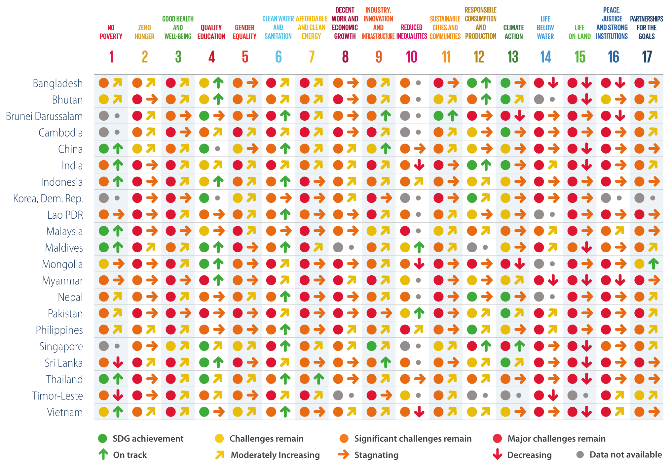
Source: Sachs et. al, 2023

Slide 27
SDG Dashboard Quiz
Pakistan has achieved which goal successfully?
Which two countries have no data available for goal 8?
Which countries have major challenges remained for goal 1?
How many countries have successfully achieved goal 4 i.e. quality education?
China ranks lowest on which 3 goals?
Which two goals have no country with SDG achievement?
Name any two countries which show moderately increasing progress towards goal 1?
Name the only country that is on track to achieve SDG 17?
Name the SDG goal that India and Bangladesh has not only achieved successfully but are still on track?
Which countries have achieved goal 16 successfully?
See the slide for teacher‘s notes for correct answers

Slide 28
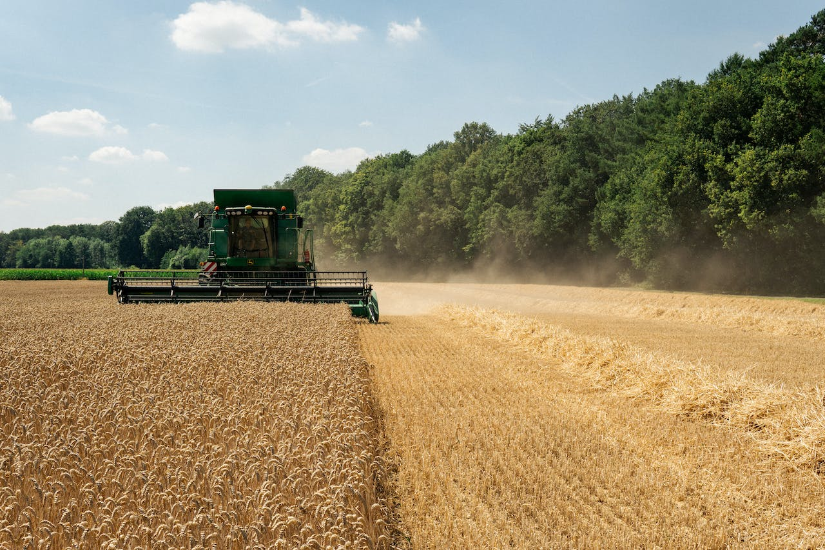
Topic 3
Pakistan’s performance on SDGs
Photo courtesy: Alex Fu (2022). https://www.pexels.com/photo/combine-harvester-on-the-field-13233162/

Slide 29
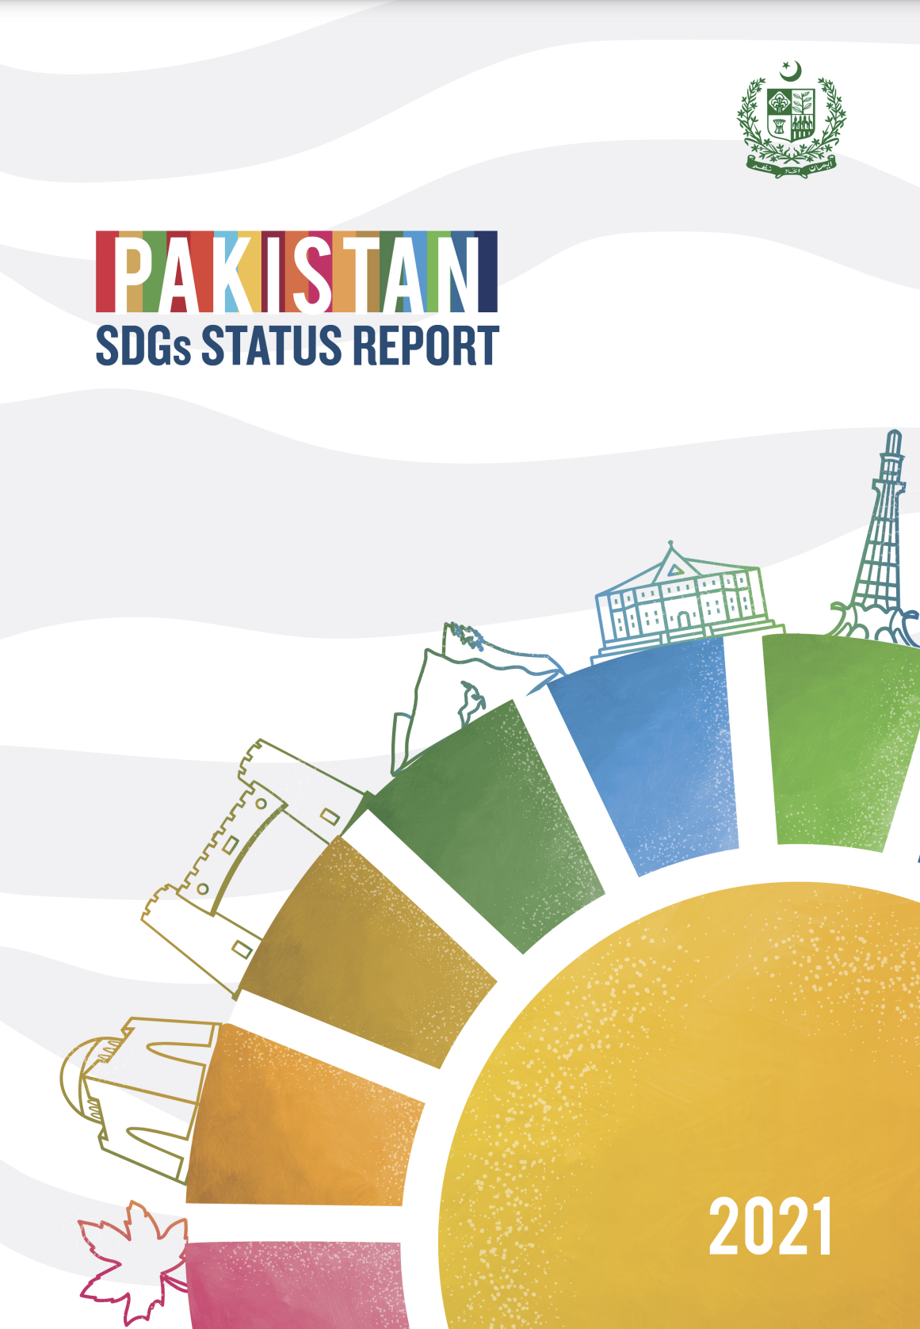
Pakistan‘s progress on SDGs
In 2021, Ministry of Planning, Development and Special Initiatives launched a special report which outlined the progress made o different SDGs (Cheema et al., 2021).
The Ministry of Planning, Development and Special Initiatives (MoPD&SI) is the focal ministry for SDGs planning, monitoring and reporting in Pakistan.
SDGs support units have also been established in all the provinces.

Slide 30
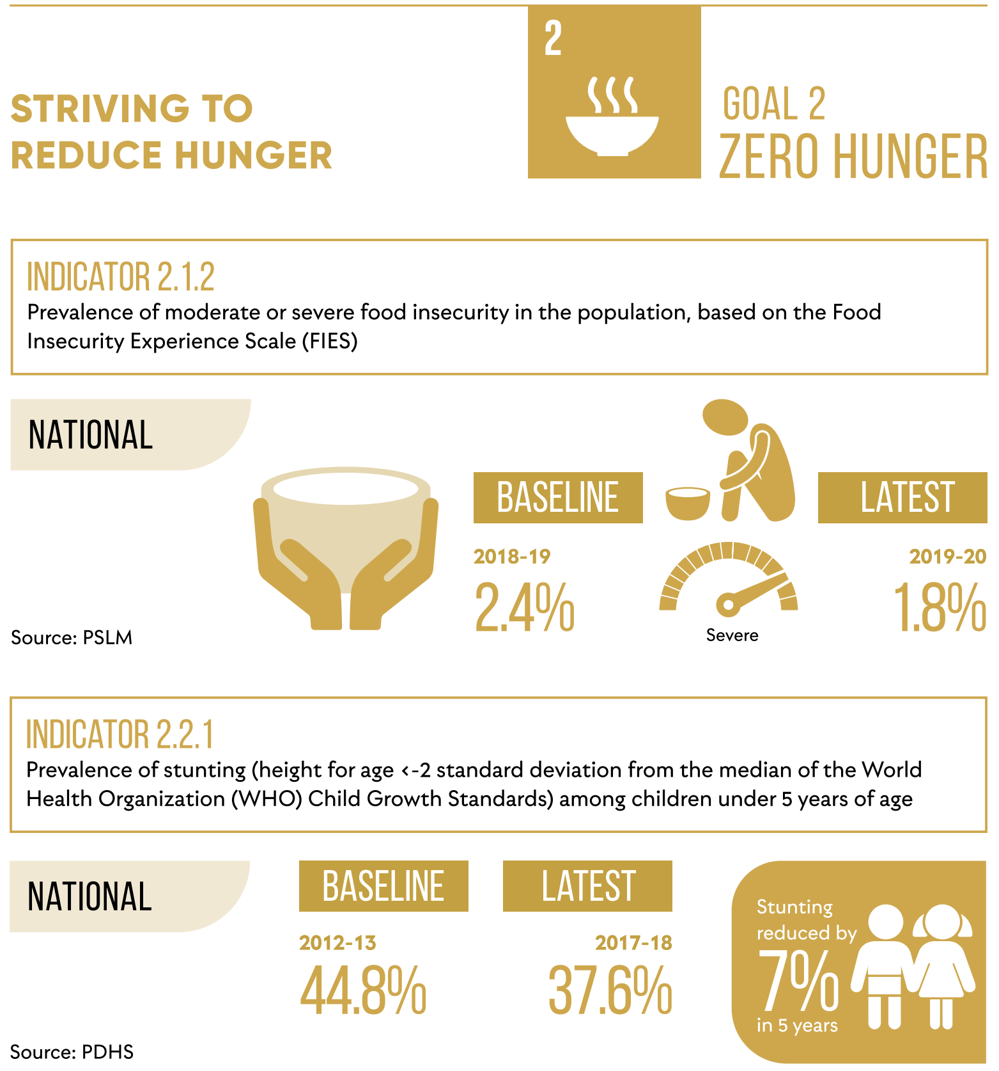
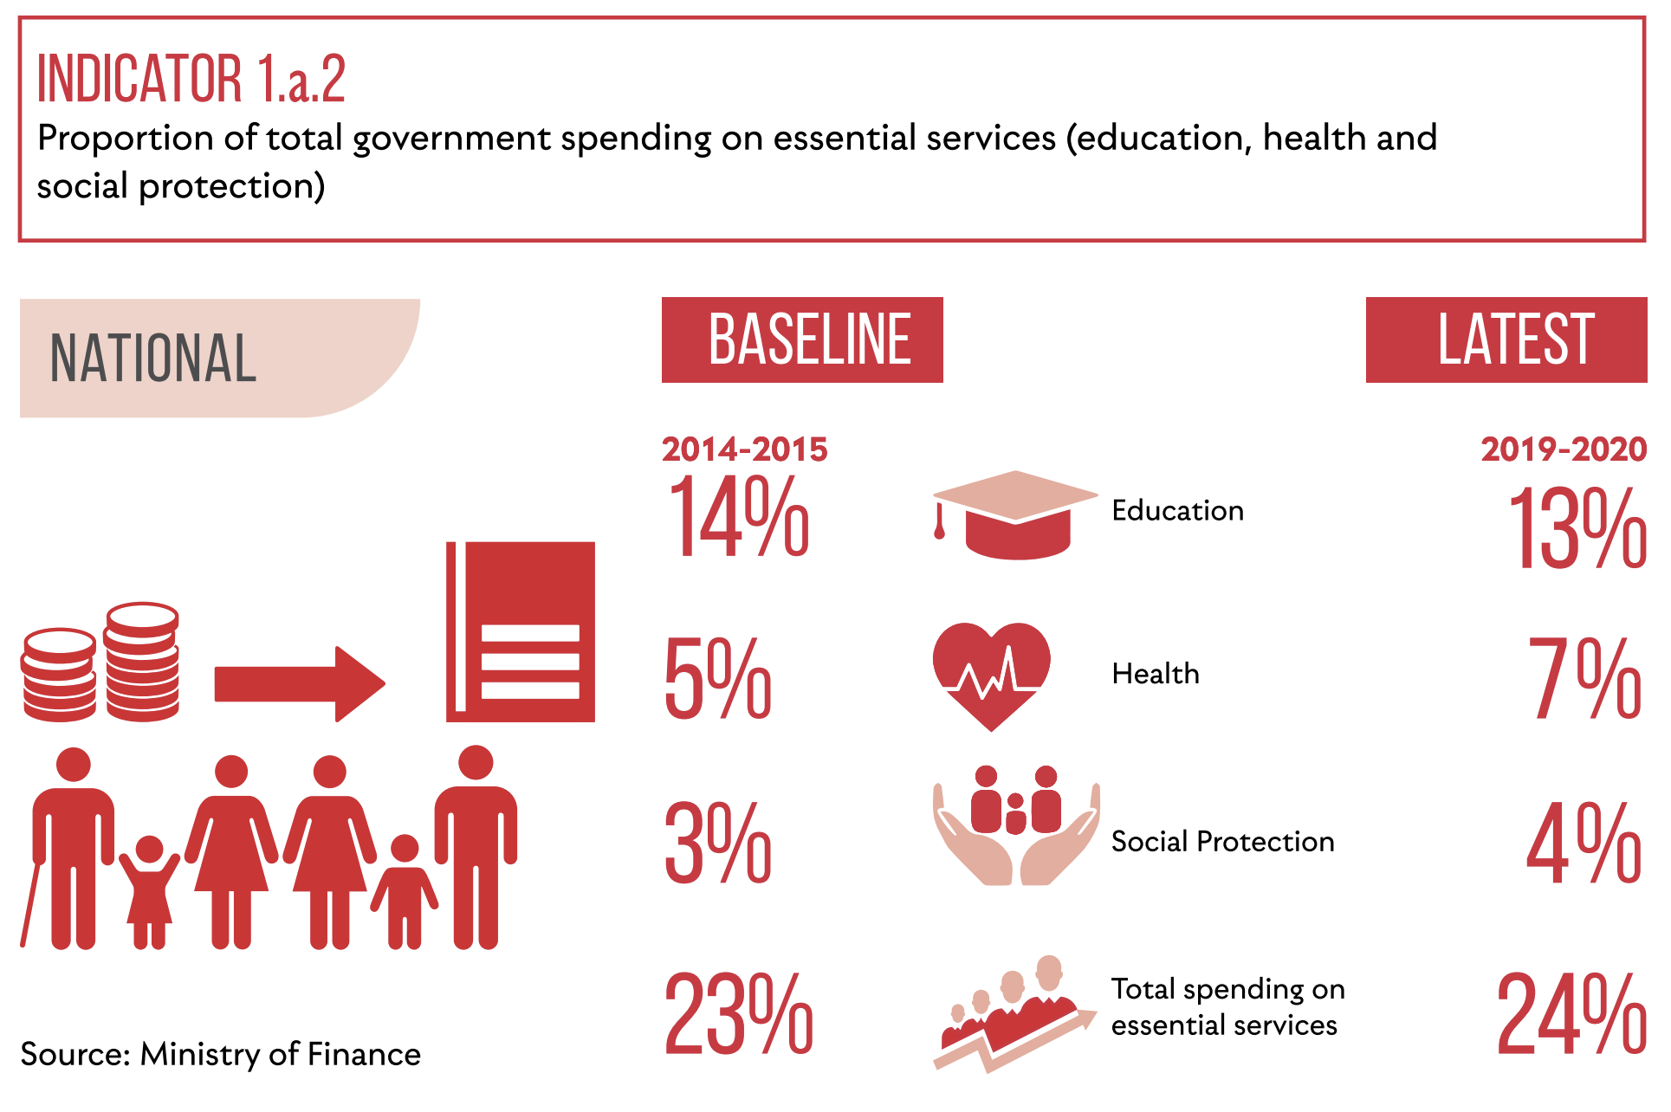
The Baseline data represents the comparison data from the previous years whereas the latest data is based on the data from recnet reference years. Gov.t spending in general has been stagnant over the years. However, there has been a decrease in severe food insecurity and child stunting at the national level.
Figure source: Cheema et al. (2021)

Slide 31
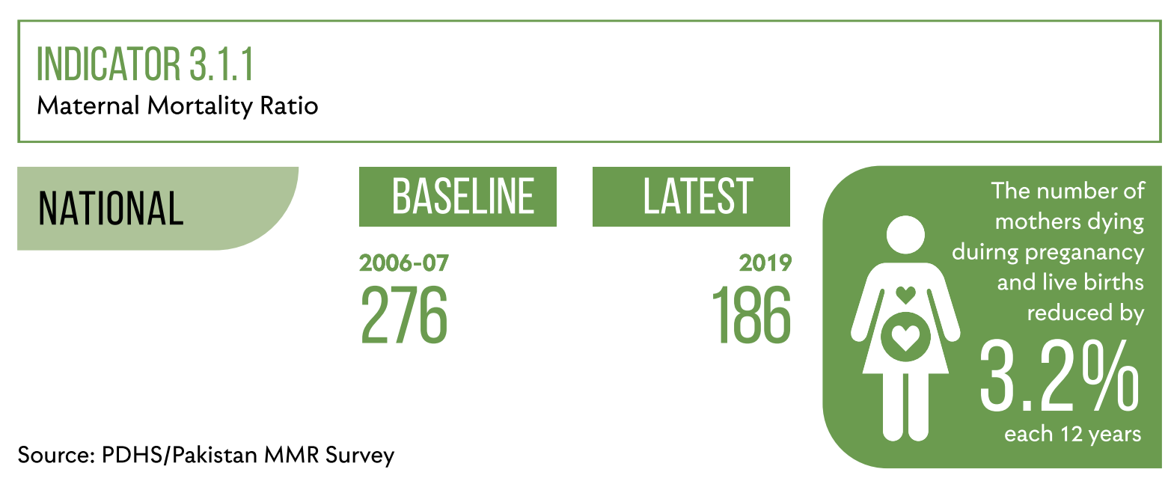
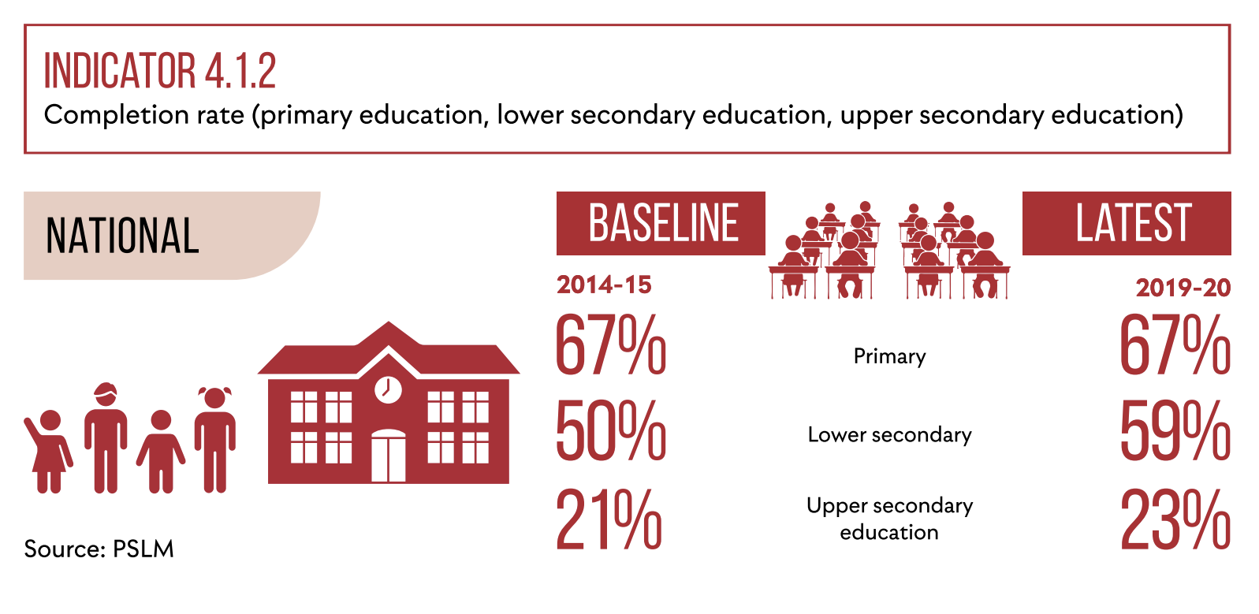
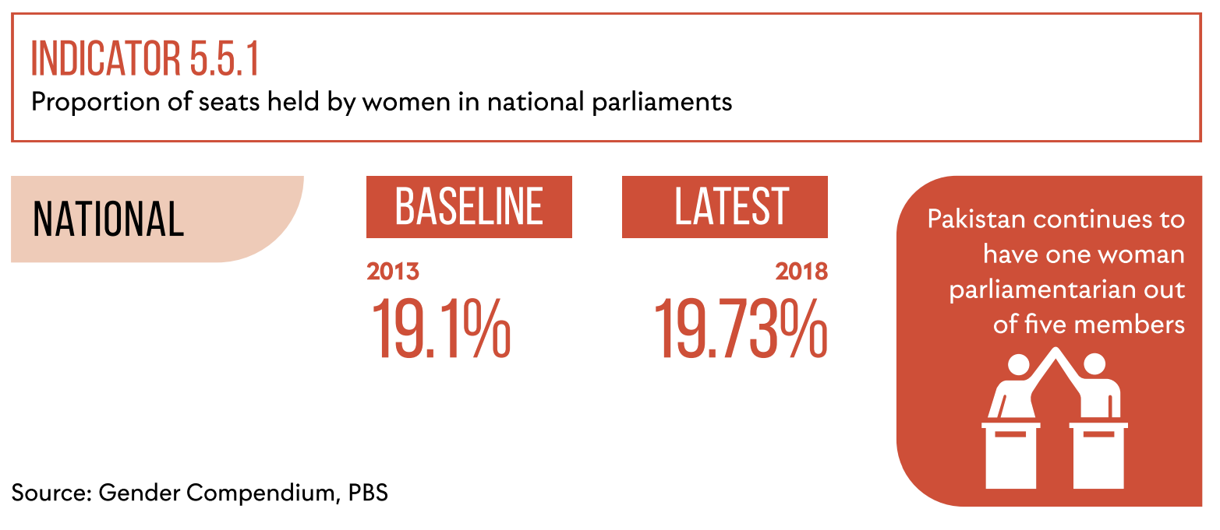
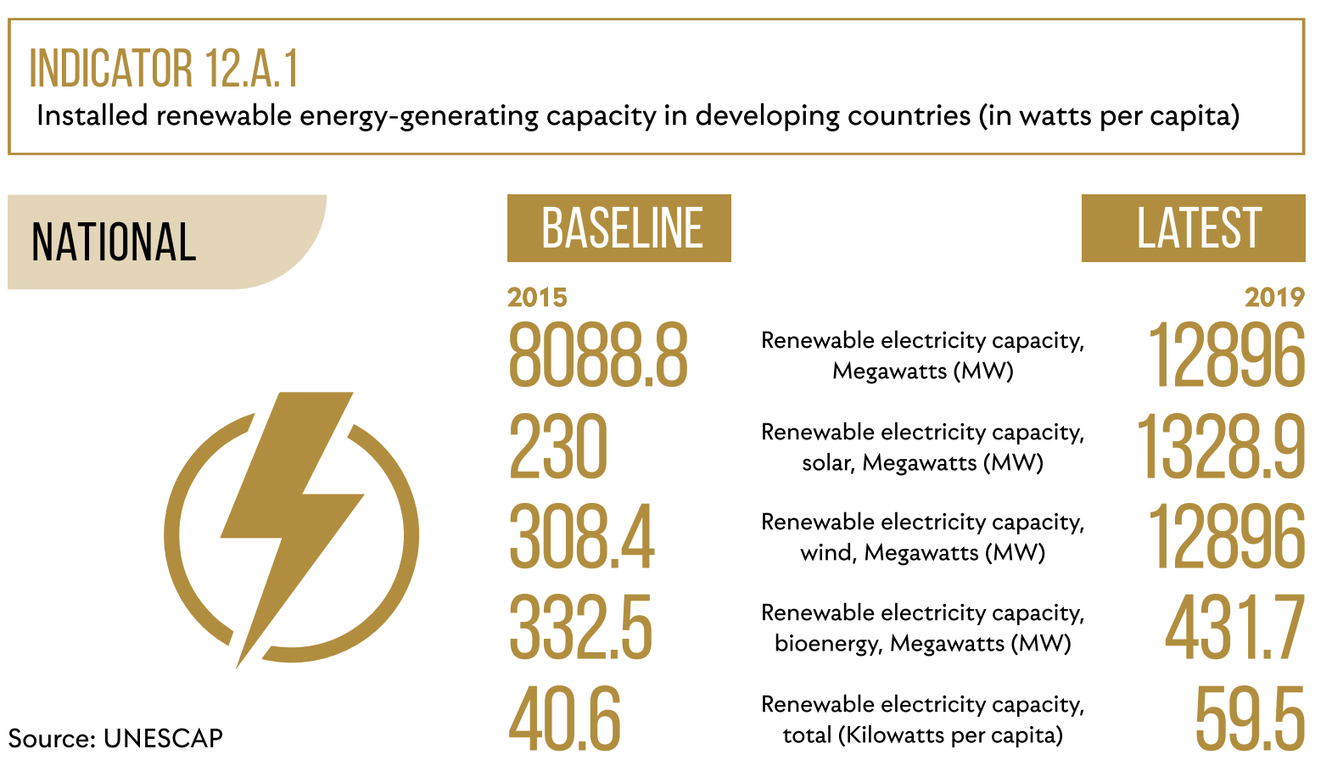
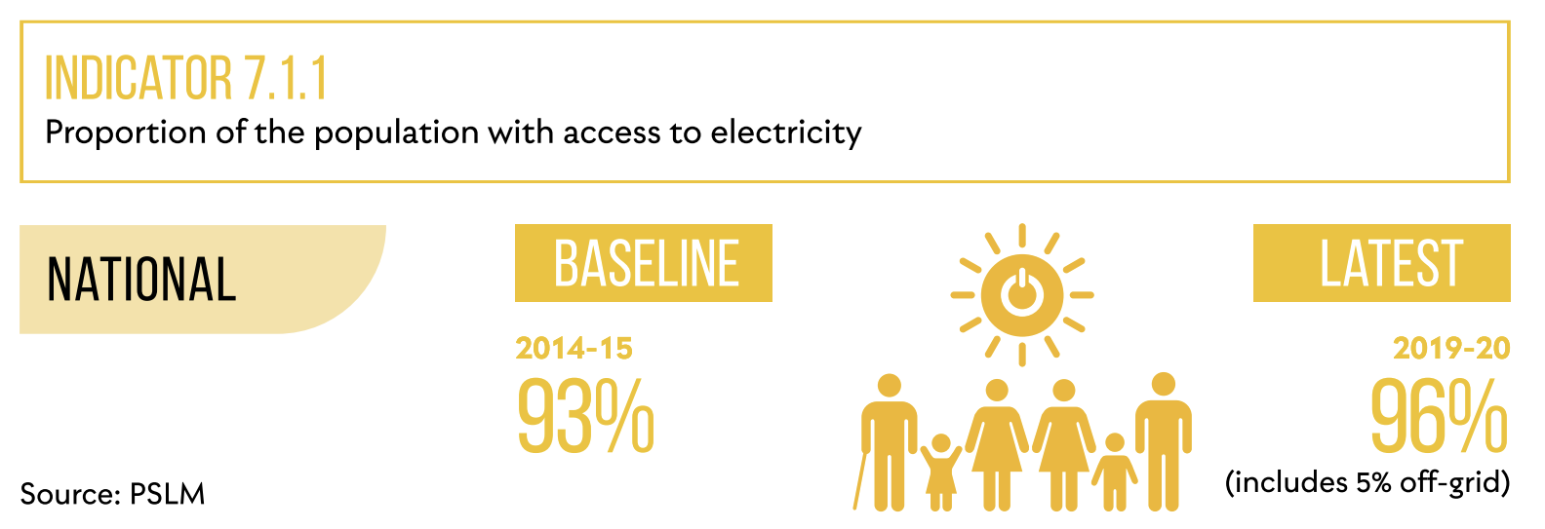
Figure source: Cheema et al. (2021)

Slide 32
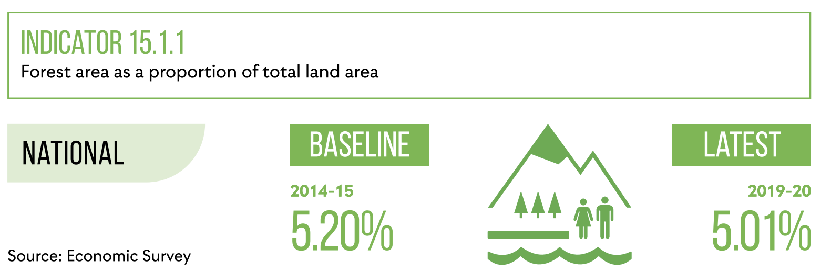
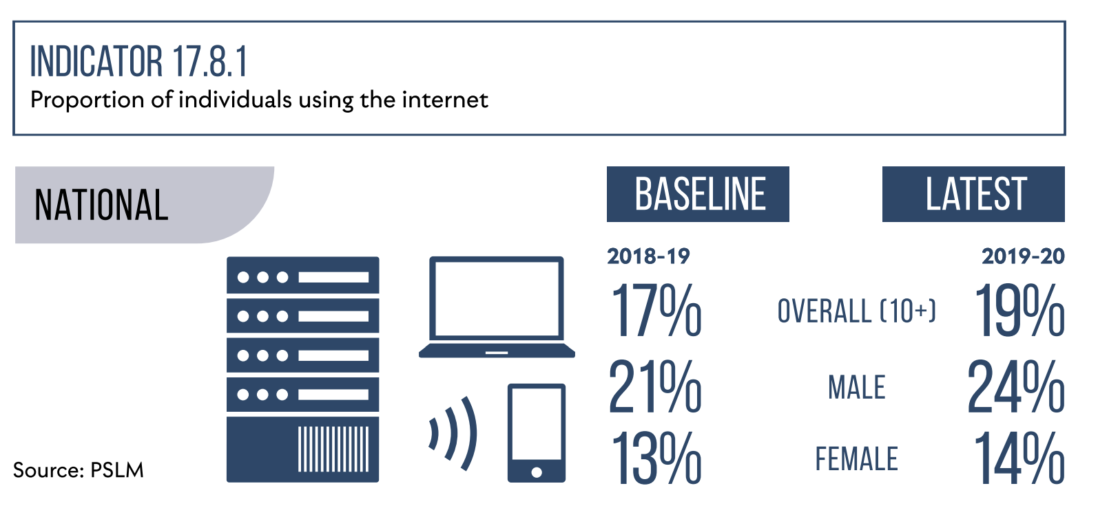
Summary
- All these indicators represents that SDGs cover a wide range of social, economic and environmental indicators.
Figure source: Cheema et al. (2021)

Slide 33
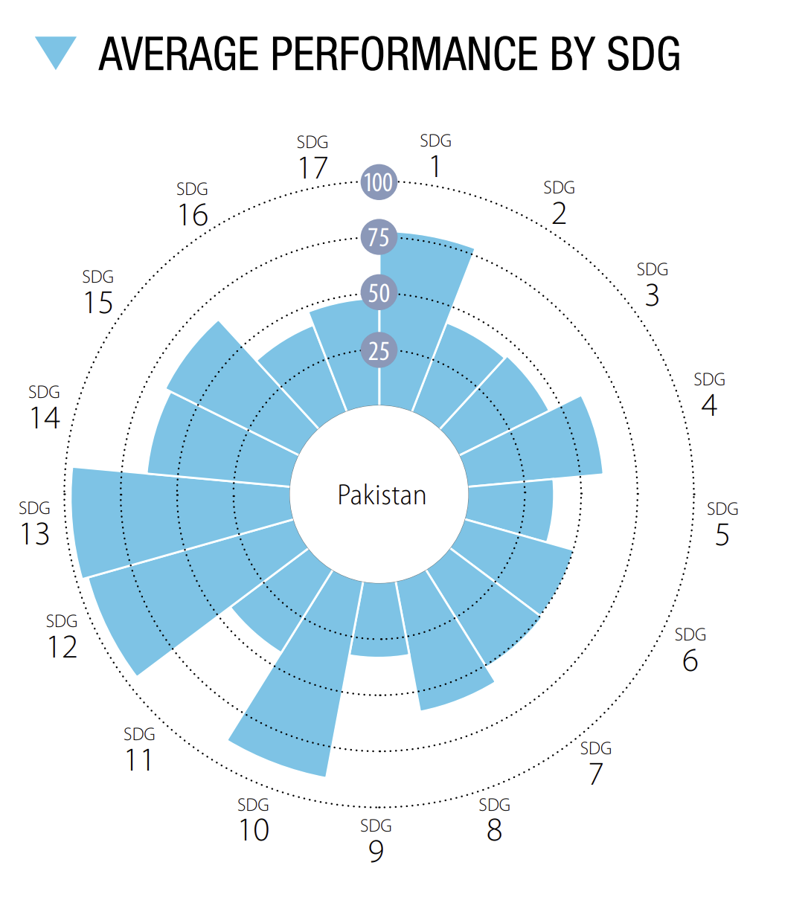
Summary
- Pakistan has shown improvement on some indicators but there‘s still a long way to go.
- Most of the progress has been made for goal 13, 12, 10 and goal 1.
Figure source: Cheema et al. (2021)

Slide 34
Discussion Question:
1. Do you think Pakistan would be able to meet all or some of the SDGs by 2030?
2. Which actions do you think are needed to achieve some of the SDGs by 2030?

Slide 35
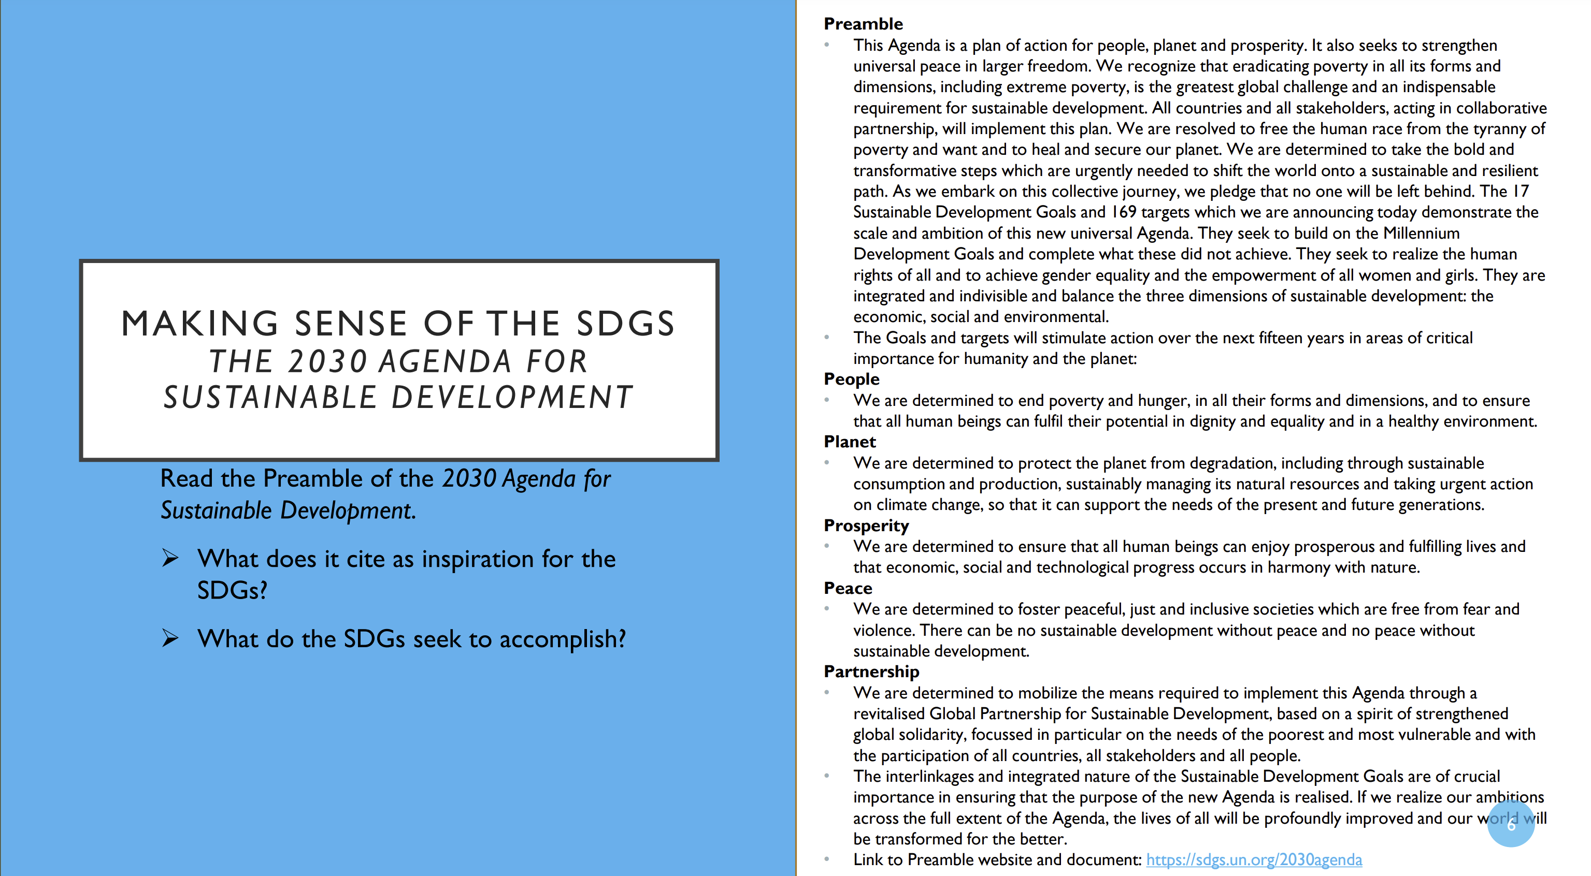
Optional: Home task
Adopted from UN‘s Teachers guide on the SDGs

Slide 36
References
Battersby, J. (2017). MDGs to SDGs – new goals, same gaps: The continued absence of urban food security in the post-2015 global development agenda. African Geographical Review, 36(1), 115–129. https://doi.org/10.1080/19376812.2016.1208769.
Hannah Ritchie and Max Roser (2018) - “Now it is possible to take stock - did the world achieve the Millennium Development Goals?” Published online at OurWorldInData.org. Retrieved from: 'https://ourworldindata.org/millennium-development-goals' [Online Resource].
Galatsidas, A., & Sheehy, F. (2015, July 6). What have the millennium development goals achieved? The Guardian. https://www.theguardian.com/global-development/datablog/2015/jul/06/what-millennium-development-goals-achieved-mdgs
Sachs, J.D., Lafortune, G., Fuller, G., Drumm, E. (2023). Implementing the SDG Stimulus. Sustainable Development Report 2023. Paris: SDSN, Dublin: Dublin University Press, 2023. 10.25546/102924
Cheema, A.R., Kemal, M., Ahmed, N. & Hassan, H., (2021). Pakistan SDGs Status Report. Federal SDGs Support Unit, Islamabad, Ministry of Planning, Development and Special Initiatives, Government of Pakistan.

Slide 37
Further Resources for teachers
de Jong, E., & Vijge, M. J. (2021). From Millennium to Sustainable Development Goals: Evolving discourses and their reflection in policy coherence for development. Earth System Governance, 7, 100087. https://doi.org/10.1016/j.esg.2020.100087.
United Nations. (2024). Student Resources. United Nations Sustainable Development. https://www.un.org/sustainabledevelopment/student-resources/.

Slide 38
Notes for Teachers
Correct answers for SDG Dashboard game:
Pakistan has achieved which goal successfully? Goal 13
Which two countries have no data available for goal 8? Maldives & timor-Leste
Which countries have major challenges remained for goal 1? None
How many countries have successfully achieved the goal 4 i.e. quality education? Two
China ranks lowest on which 3 goals? 14, 15 & 16
Name at least two goals which have no country with SDG achievement? 2, 3, 14, 15, 16, 17
Name any two countries which show moderately increasing progress towards goal 1? Bangladesh, Bhutan, Nepal, Pakistan, Philippines
Name the only country that is on track to achieve SDG 17? Mongolia
Name the SDG goal that India and Bangladesh has not only achieved successfully but are still on track? Goal 12
Which countries have achived goal 16 successfully? None

